Slide 1
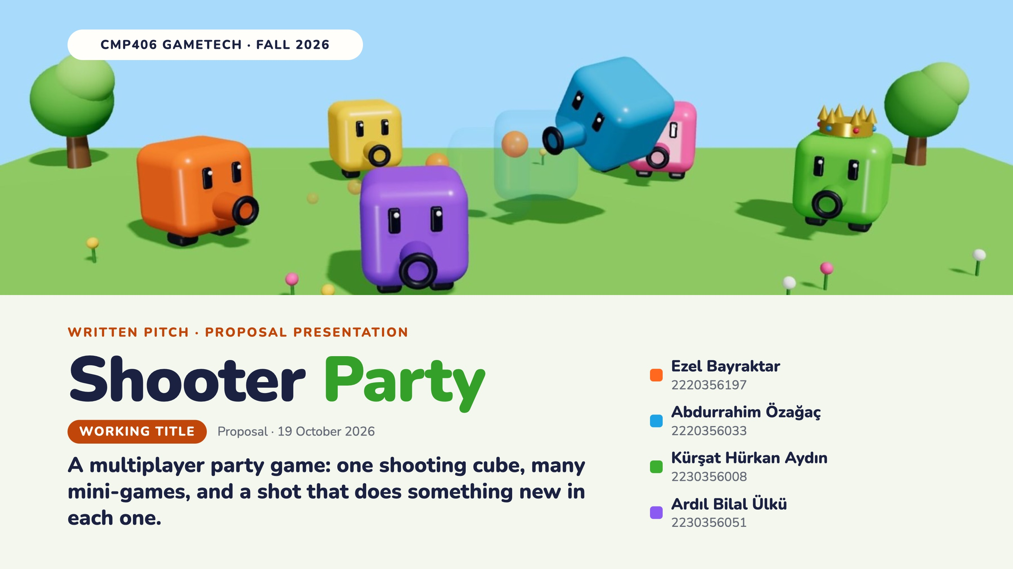
Notes:
Introduce the team: Ezel (online system, sound), Abdurrahim (core prototype, scoreboard), Kürşat (UI design, sound and music) and Ardıl (menus, promo video). Everyone also designs one mini-game. Then the one-line pitch: a multiplayer party game with one shooting cube, many mini-games, and a shot that does something new in each one. Shooter Party is a working title.

Slide 2
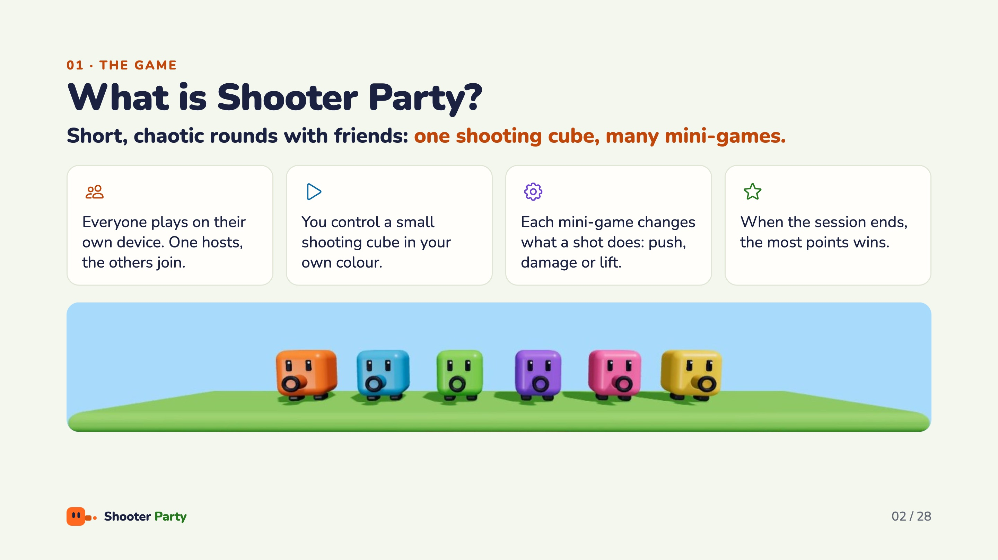
Notes:
Plain-language intro, no jargon. Shooter Party is a multiplayer party game. Each player plays on their own device: one hosts the session and the others join over the network. Everyone controls a small shooting cube in their own colour. The mini-games change what a shot does: one pushes, one damages, one lifts you with a blast. When the session ends, the player with the most points wins.

Slide 3
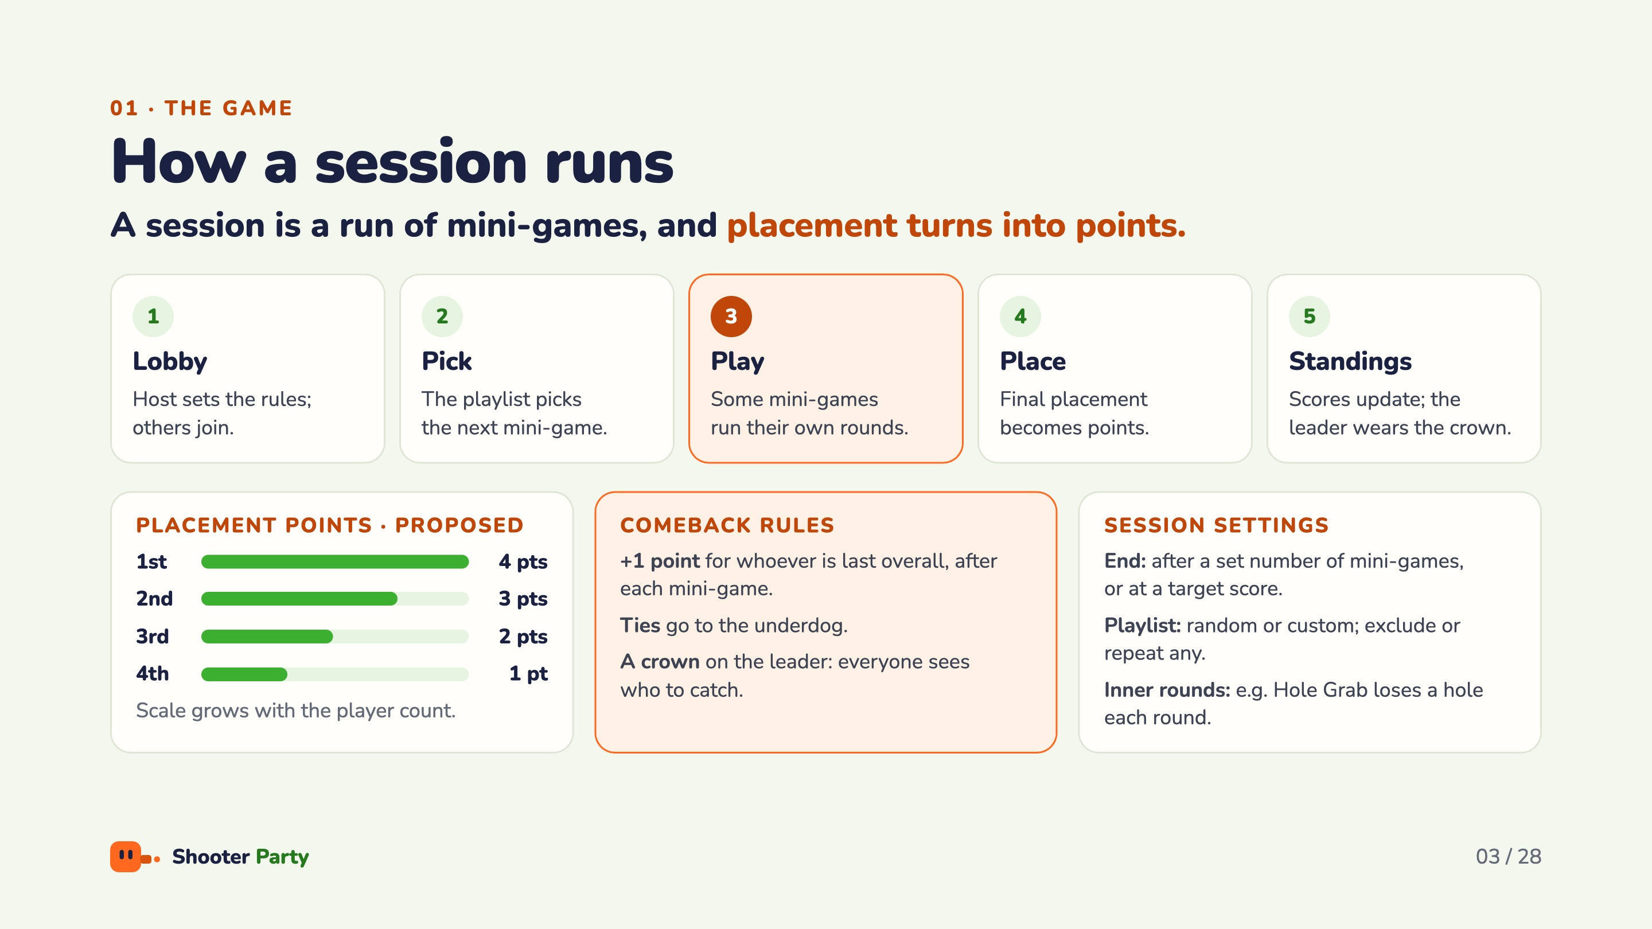
Notes:
Walk the five steps: lobby, pick, play, place, standings. Placement points are a proposal: 4-3-2-1 for four players, and the scale grows with more players. The comeback rules give an edge to whoever is behind: +1 bonus point for last place after each mini-game, ties go to the underdog, and the leader wears the crown so everyone knows who to catch. The host chooses the end condition (number of mini-games or target score) and a random or custom playlist.

Slide 4
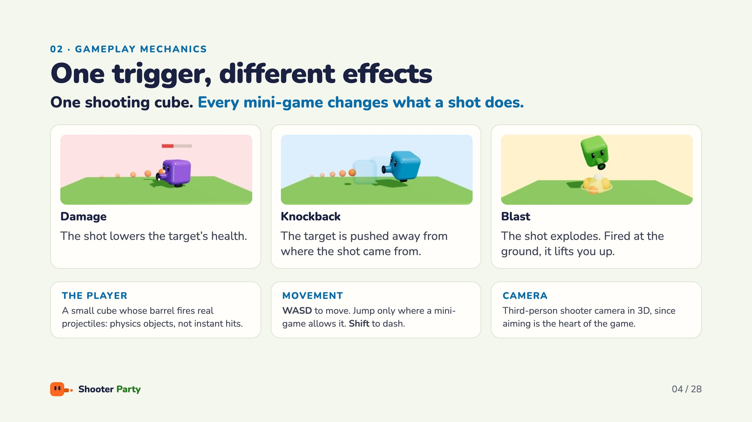
Notes:
The player is a small character whose barrel fires real projectiles: physics objects, not instant hits. It does not have to be a cube, but proportions stay close to 1:1:1, and every player gets a different colour. One trigger, three effects: damage lowers health, knockback pushes the target away from where the shot came from, and blast explodes and lifts you when fired at the ground. Dash is on a cooldown or comes as charges from a power-up. A mini-game can adjust the camera where it needs to.

Slide 5
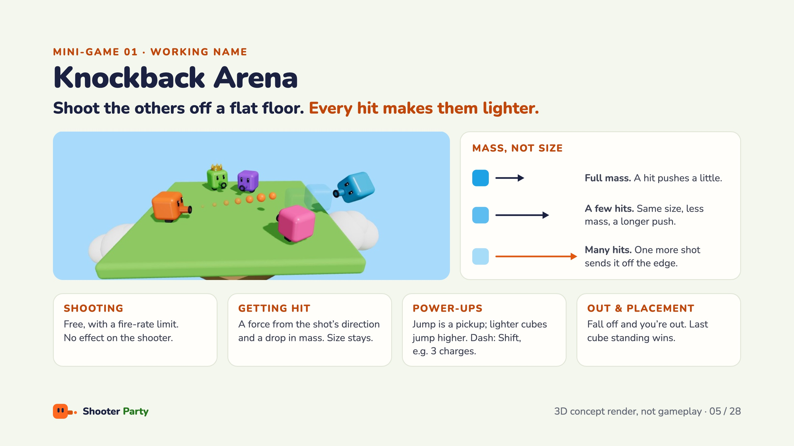
Notes:
Owner: Abdurrahim. Shoot the others off a flat floor. The key rule is mass, not size: every hit lowers the target’s mass while its size stays, so the same shot sends it further each time, until one more shot sends it off the edge. Shots are real thrown objects with a fire-rate limit and no effect on the shooter. Jump is strong, so it is a pickup; a lighter cube jumps higher. Placement is by order of elimination. Arena theme and size are not set yet.

Slide 6
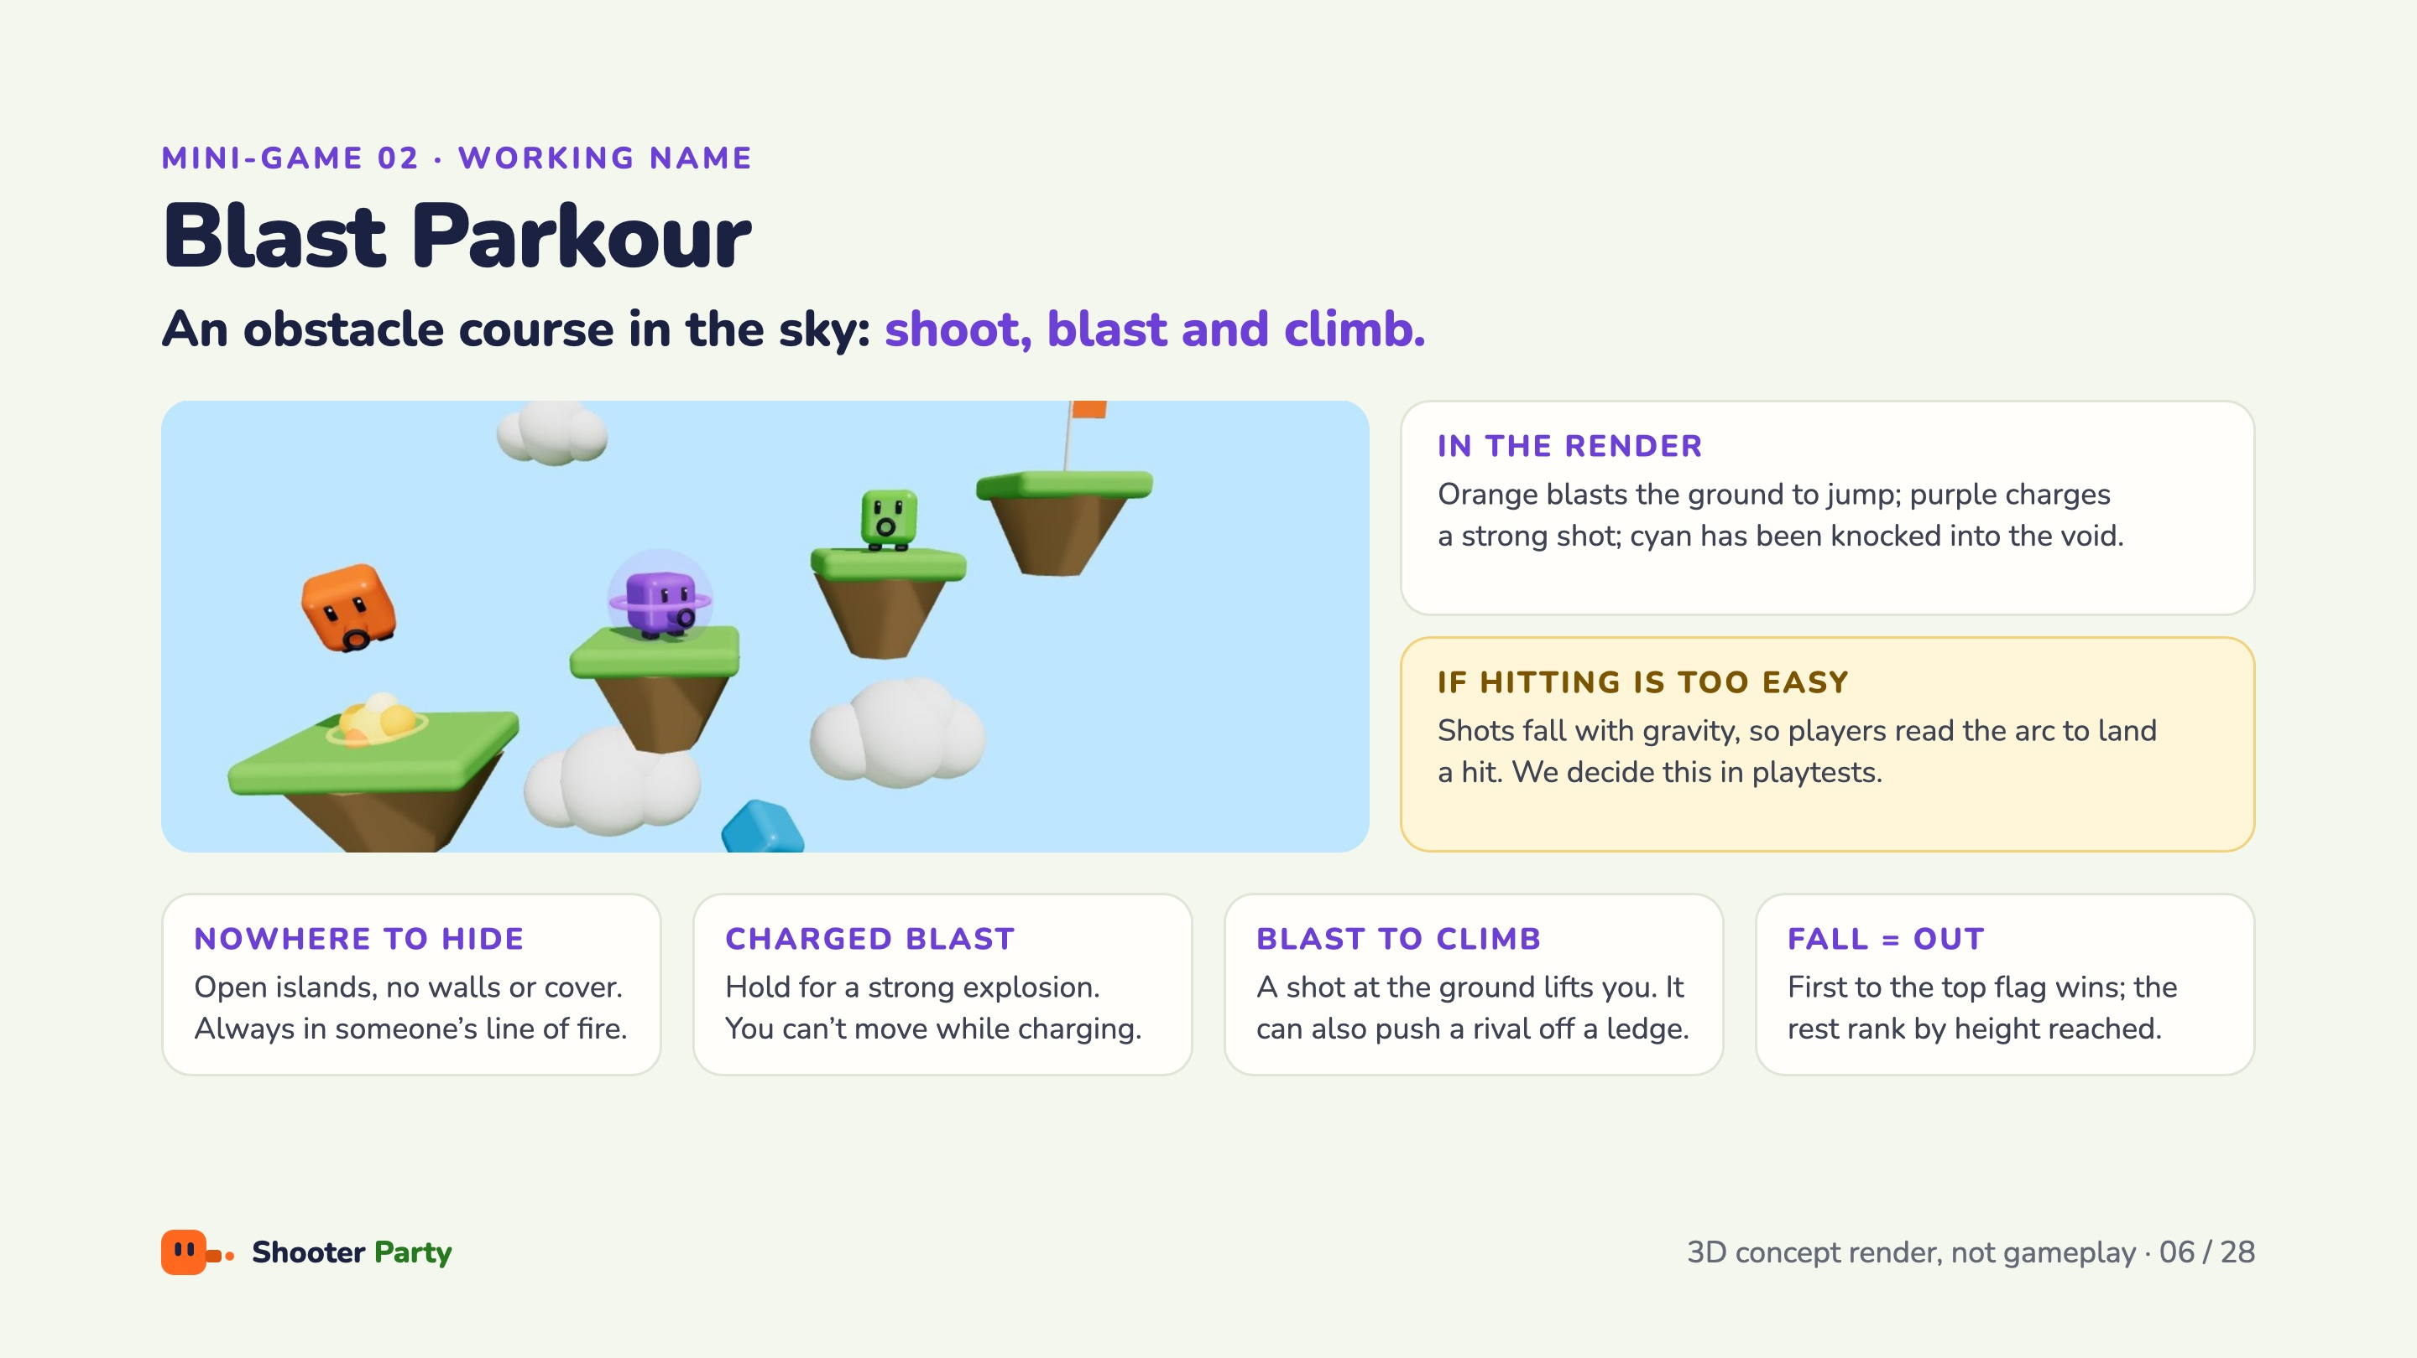
Notes:
Owner: Ardıl. An obstacle course in the sky: shoot, blast and climb while knocking the others into the void. Open islands with no walls or cover, so everyone is always in someone’s line of fire. A shot at the ground lifts you; the same blast can push a nearby rival off a ledge. Hold to fire a strong explosion, but while charging you cannot move, so you are open to attack. Whoever drops below the course is out; first to the top flag wins, the rest are ranked by height. If hitting is too easy, shots fall with gravity; we decide in playtests.

Slide 7
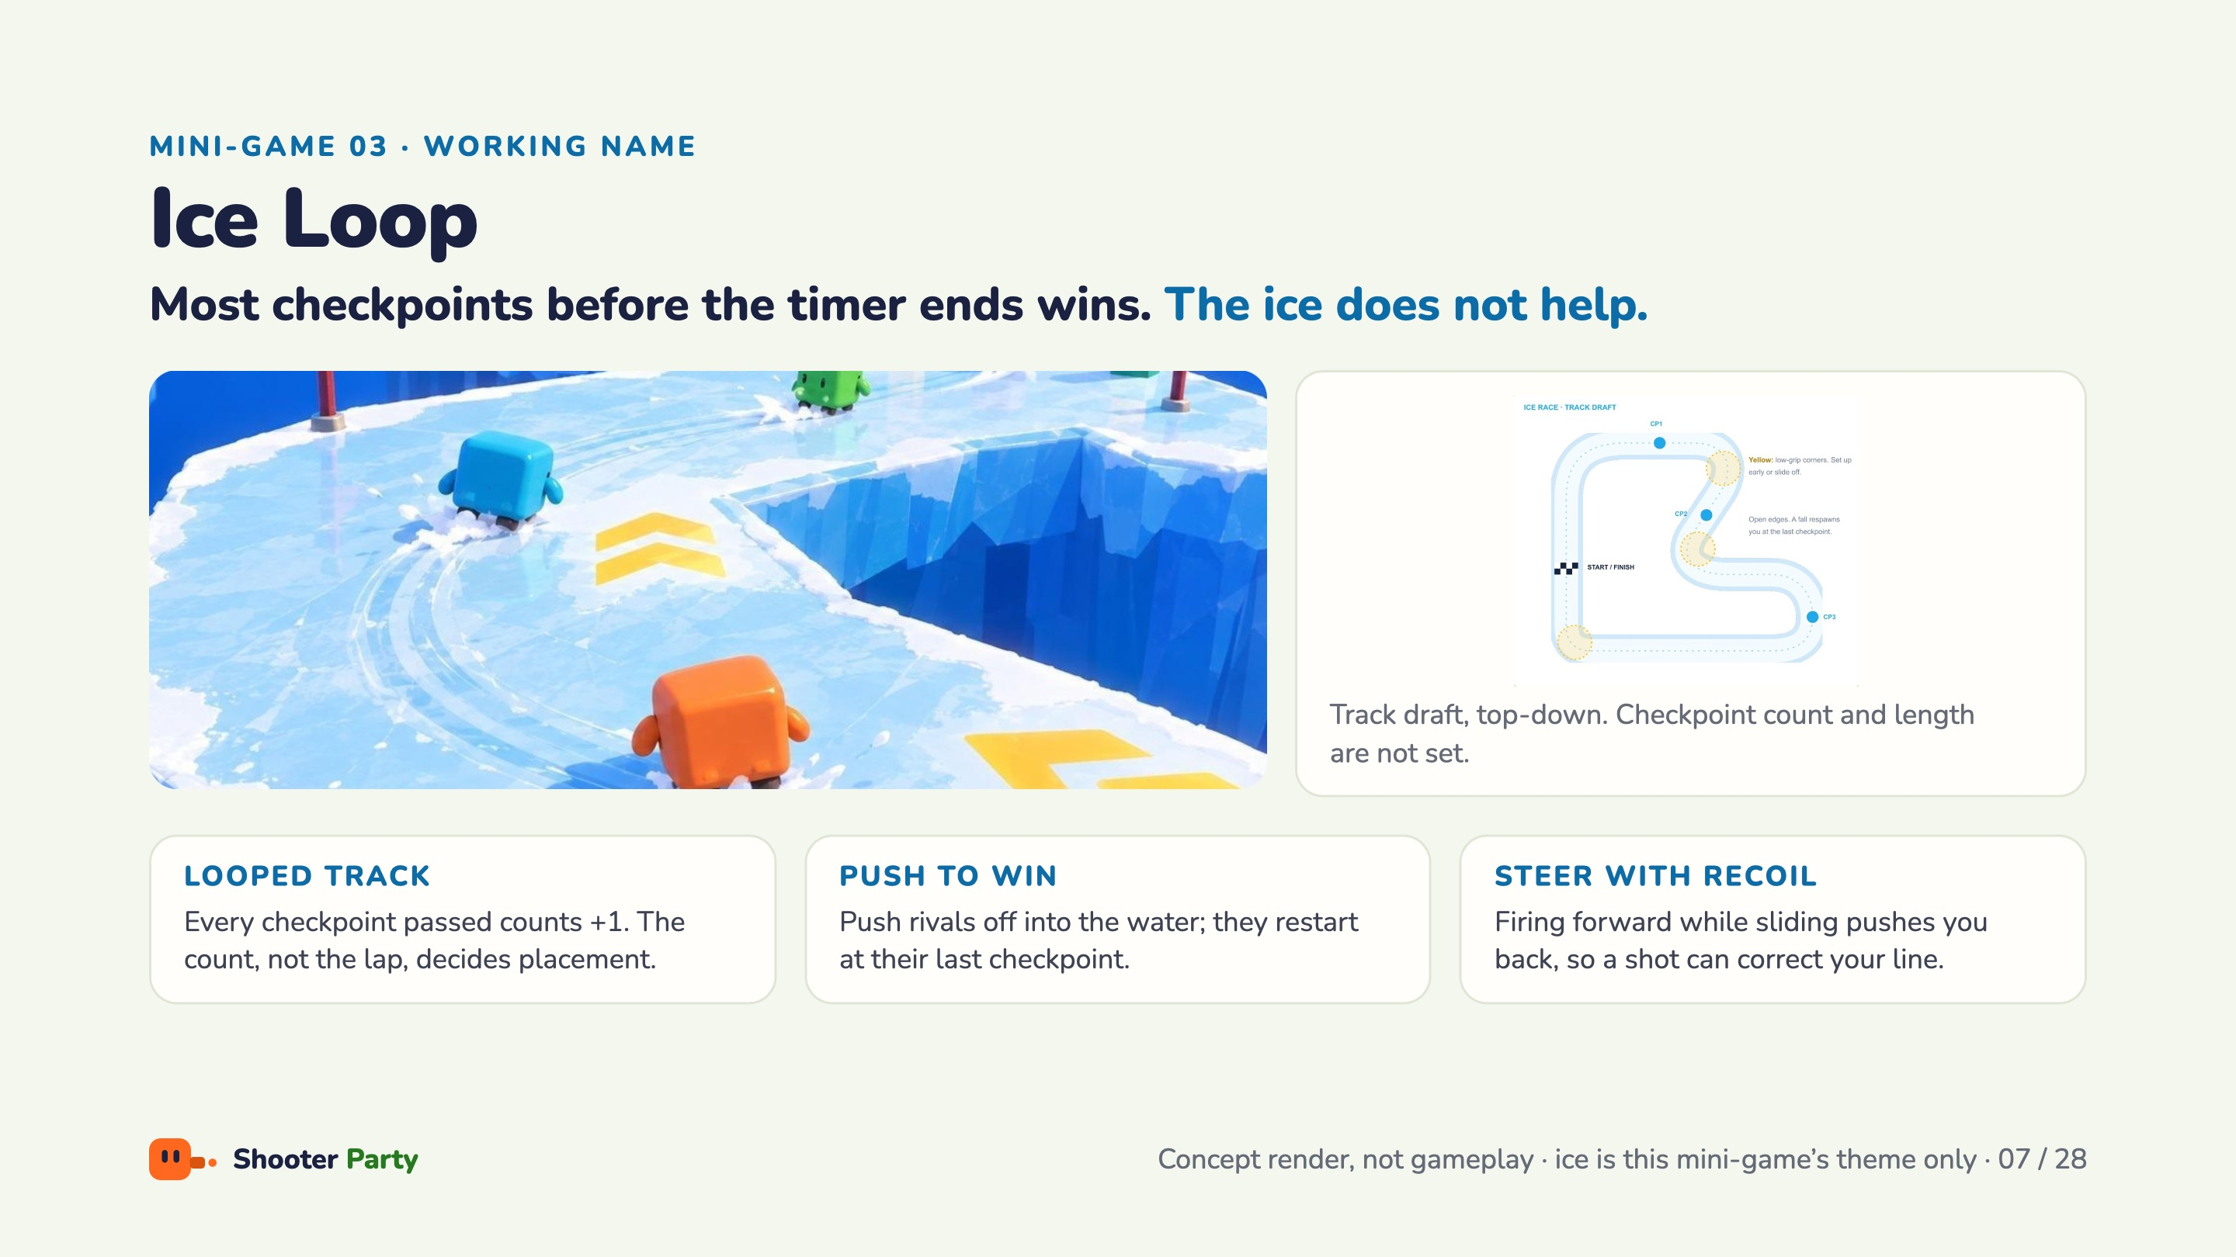
Notes:
Owner: Kürşat. Most checkpoints before the timer runs out wins. When the track ends it starts again, and every checkpoint you pass counts +1; the count, not the lap, decides the placement. The ice is slippery: push rivals off it into the water and they restart from their last checkpoint. Firing forward while sliding pushes you back, so a shot can also correct your line. Ice is the theme of this one mini-game only.

Slide 8
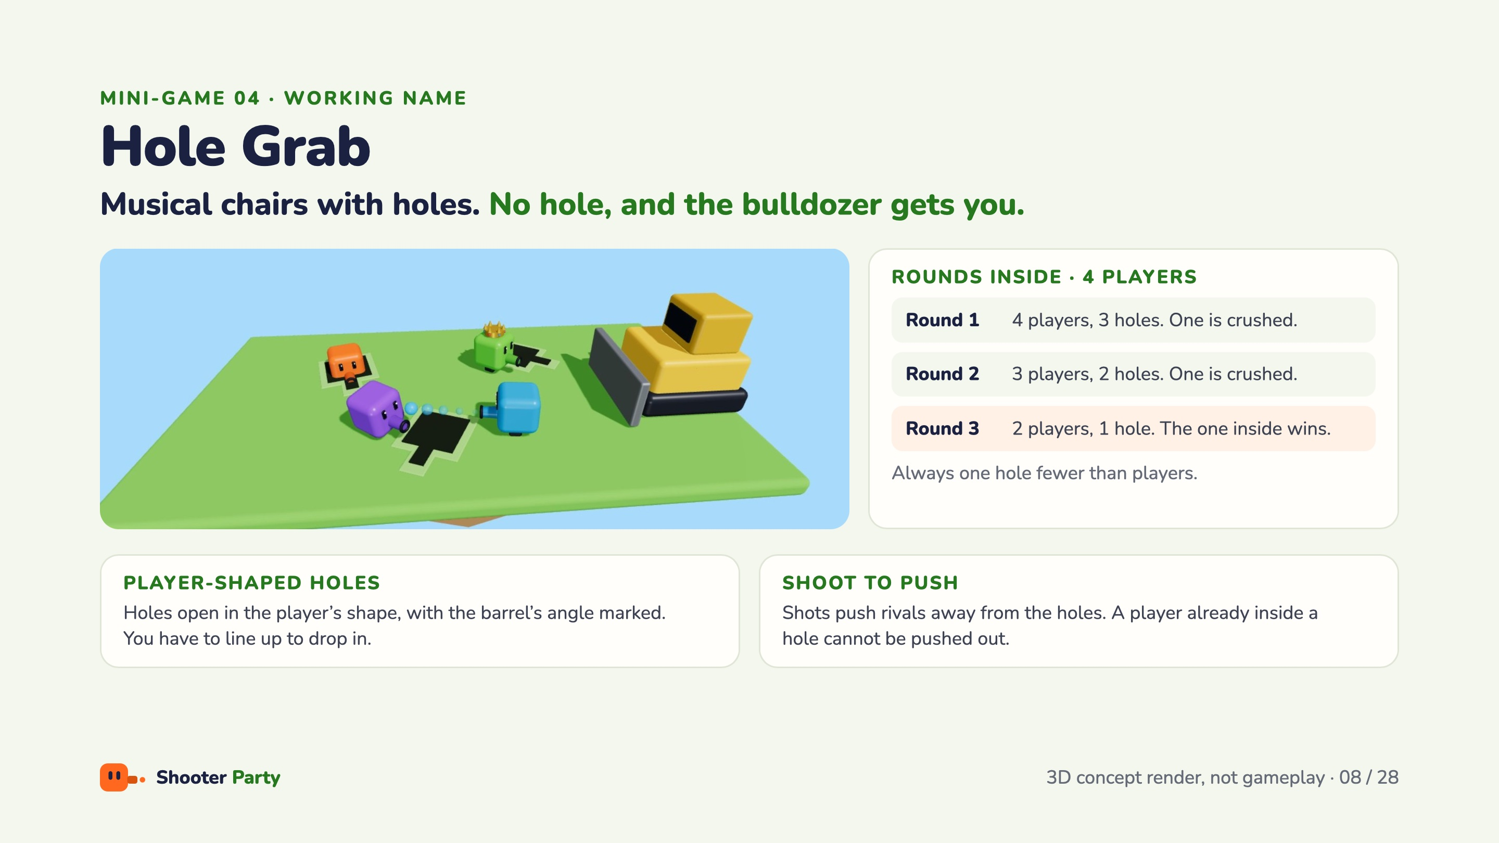
Notes:
Owner: Ezel. Musical chairs with holes: if you have no hole, the bulldozer gets you. Holes open in the ground in the player’s shape, with a fixed barrel slot, so you have to line up to drop in. Shots push other players away from the holes; a player already inside cannot be pushed out. Each round has one hole fewer than players: with four players, rounds go 3 holes, 2 holes, 1 hole, and the one inside the last hole wins. More players means more holes.

Slide 9
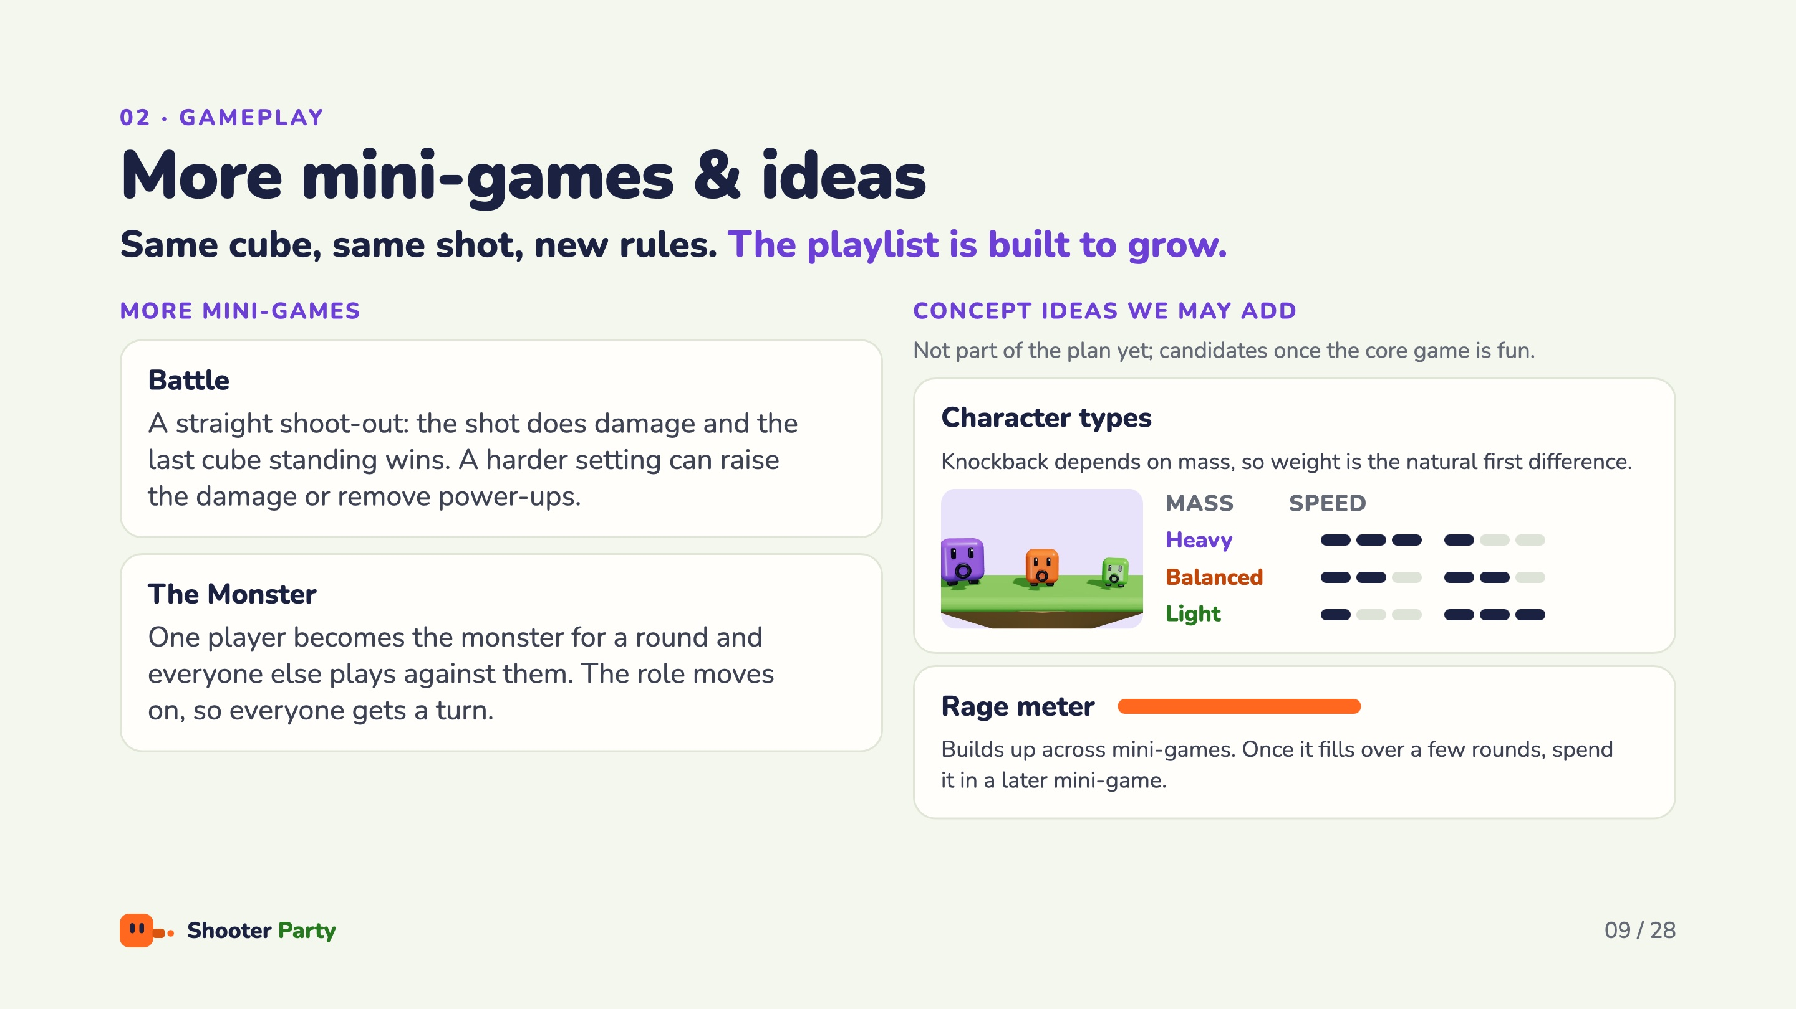
Notes:
Same cube, same shot, new maps and rules: the playlist is built to grow. Battle is a straight shoot-out where the shot does damage; Battle is next in line once the four main mini-games are fun. In The Monster, one player is the monster for a round and everyone else plays against them. Concept ideas, not part of the plan yet: character types (heavy, balanced, light), since knockback depends on mass, and a rage meter that builds across mini-games and can be spent in a later one.

Slide 10
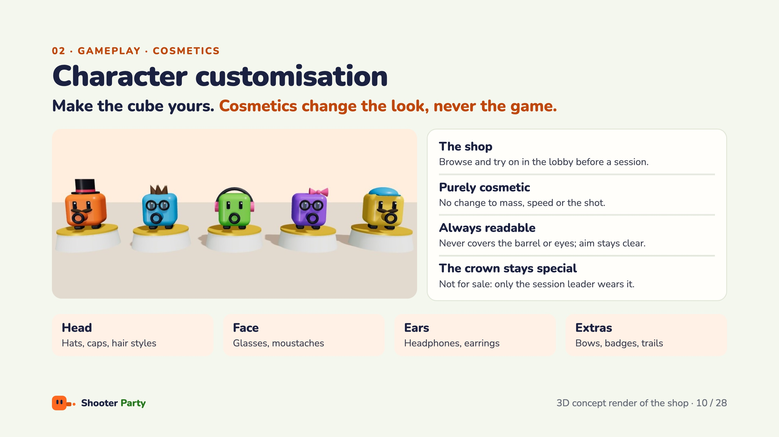
Notes:
Make the cube yours: cosmetics change the look, never the game. Four slots: head, face, ears and extras. In the in-game shop players browse cosmetics, try them on in the lobby and dress their cube before a session. Nothing in the shop changes mass, speed or the shot, so every player stays on equal terms. Cosmetics never cover the barrel or the eyes, so where a player is aiming stays clear. The crown is not for sale: only the current session leader wears it.

Slide 11
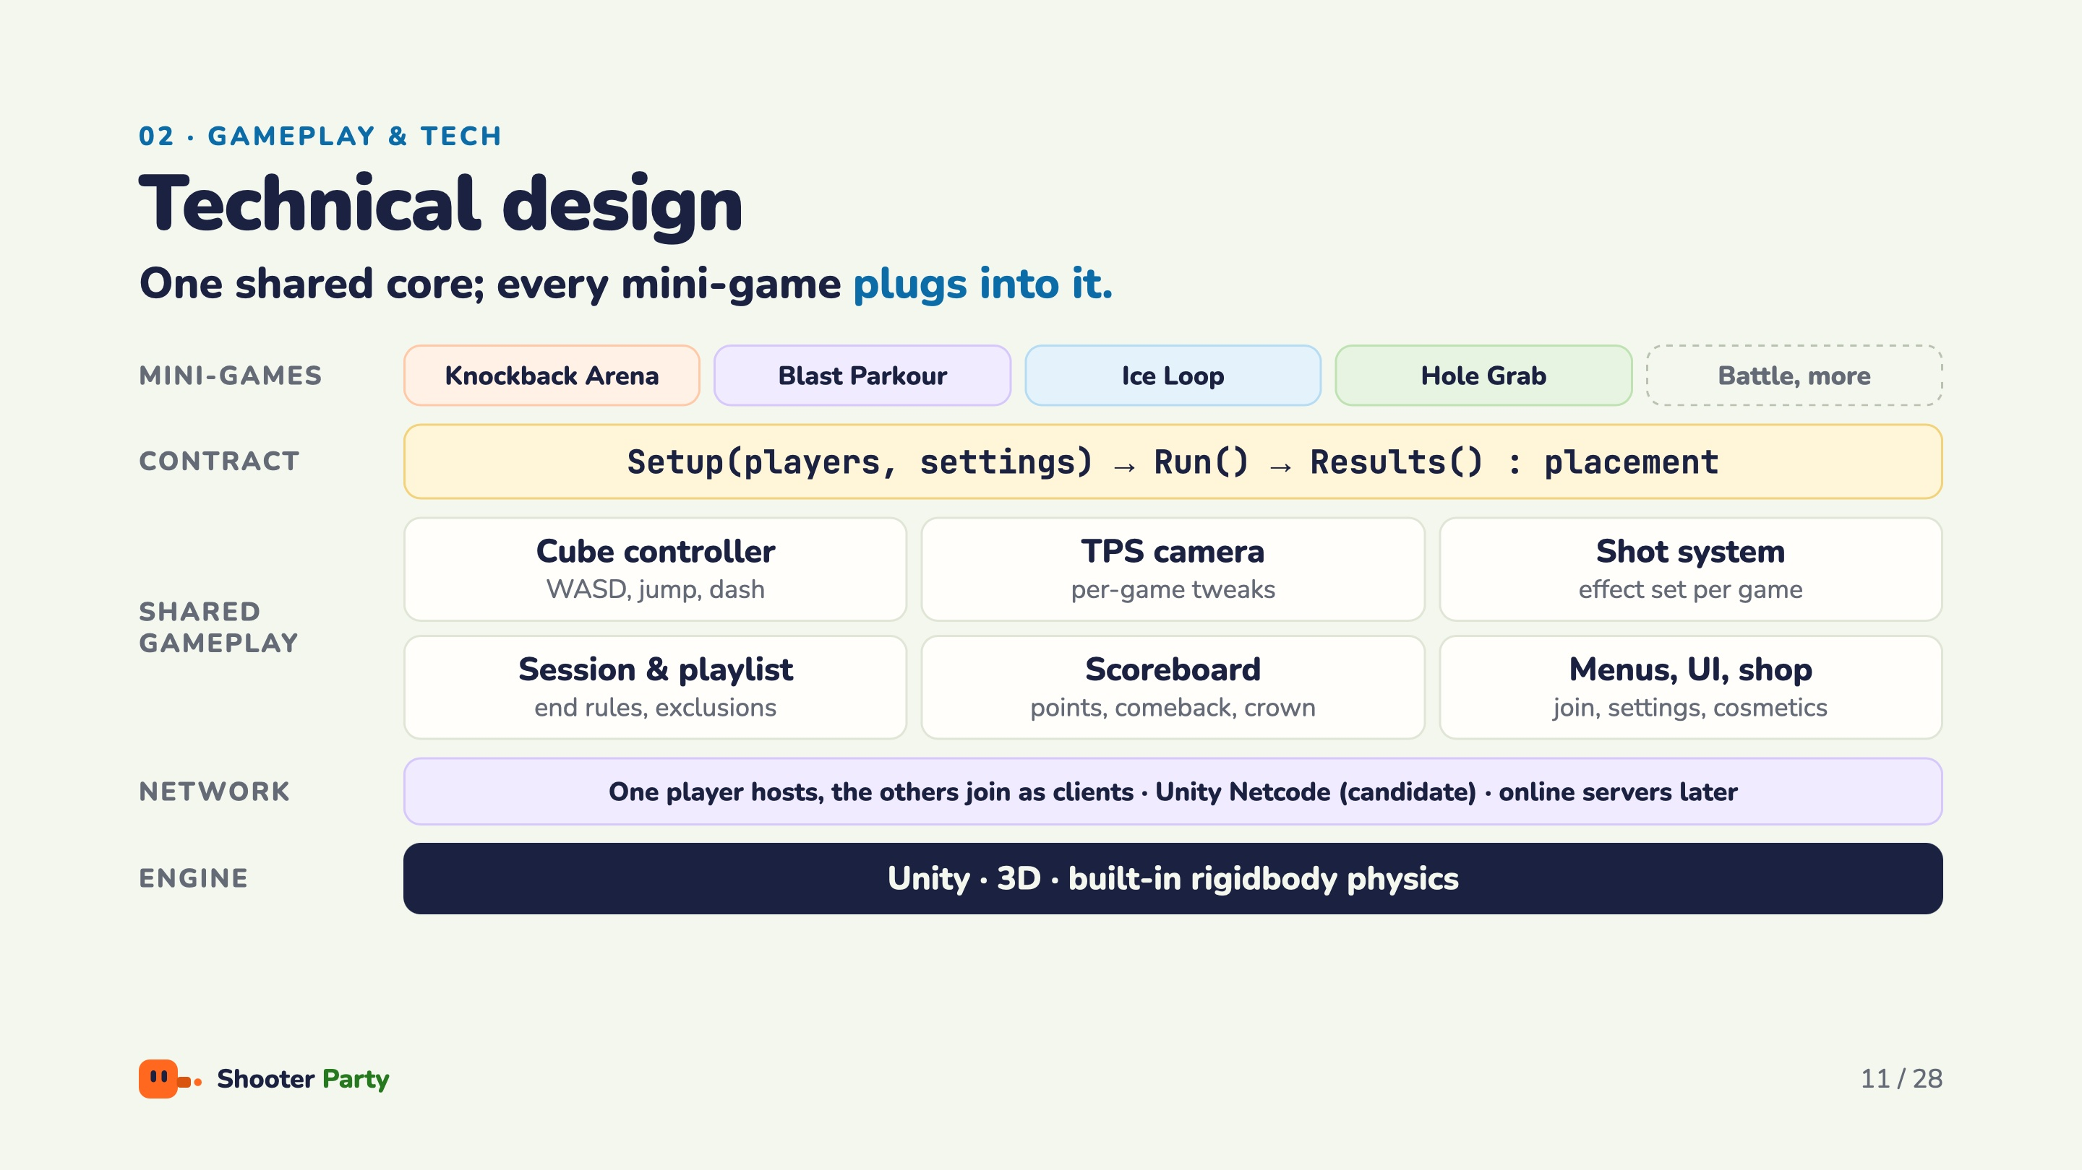
Notes:
Read the stack from the bottom up. Engine: Unity, 3D, built-in rigidbody physics. Network: one player hosts and the others join as clients; Unity Netcode is our candidate, online servers come later. Shared gameplay: cube controller, third-person camera, shot system, session and playlist, scoreboard, and menus, UI and shop. Every mini-game plugs in through one contract: Setup with players and settings, Run, then Results returns the placement. Adding a mini-game means implementing that contract.

Slide 12
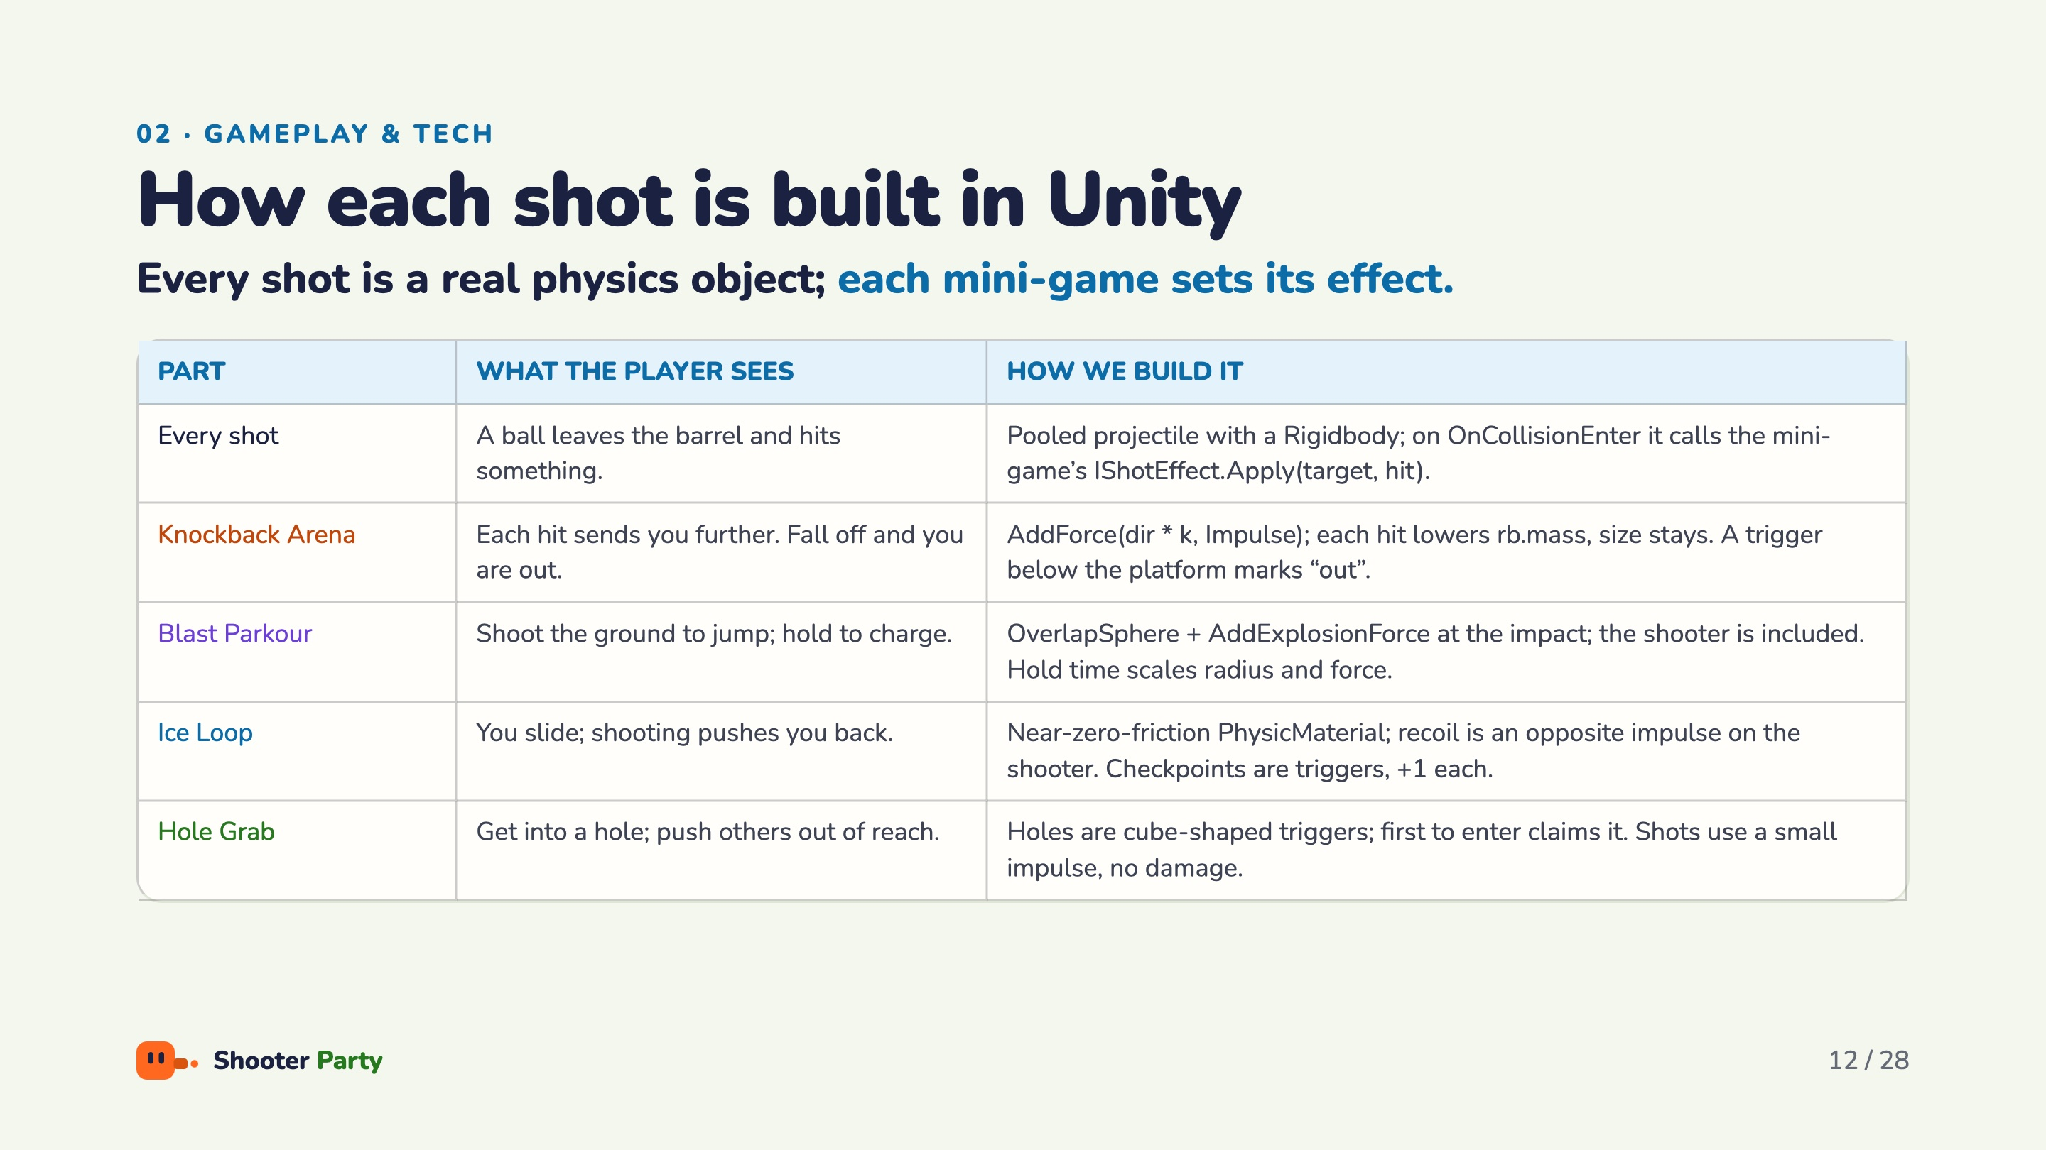
Notes:
Every shot is a pooled projectile with a Rigidbody. When it collides, it calls the current mini-game’s IShotEffect.Apply, so the same shot code serves every mini-game. Knockback Arena: AddForce as an impulse and lower the target’s rb.mass; size stays; a trigger under the platform marks out. Blast Parkour: OverlapSphere plus AddExplosionForce at the impact, shooter included, hold time scales the radius and force. Ice Loop: a near-zero-friction PhysicMaterial, recoil is an opposite impulse on the shooter, checkpoints are triggers. Hole Grab: cube-shaped hole triggers, first to enter claims it, shots use a small impulse with no damage.

Slide 13
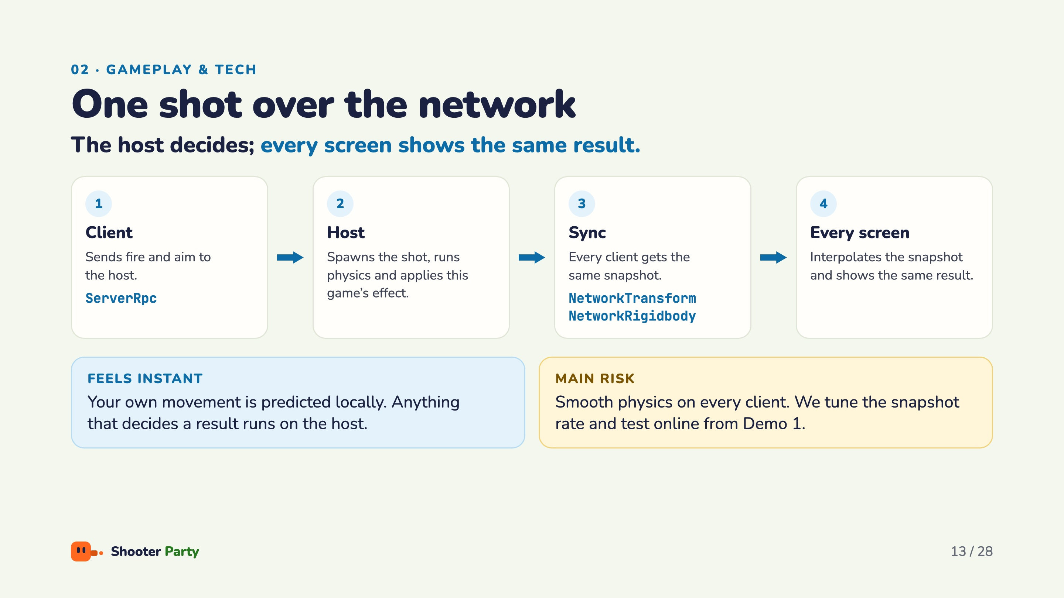
Notes:
One shot over the network: the client sends fire and aim with a ServerRpc; the host spawns the shot, runs the physics and applies this game’s effect; every client gets the same snapshot through NetworkTransform and NetworkRigidbody and interpolates it. Your own movement is predicted locally, so it feels instant, but anything that decides a result runs on the host. The main risk is smooth physics on every client, so we tune the snapshot rate and test online from Demo 1.

Slide 14
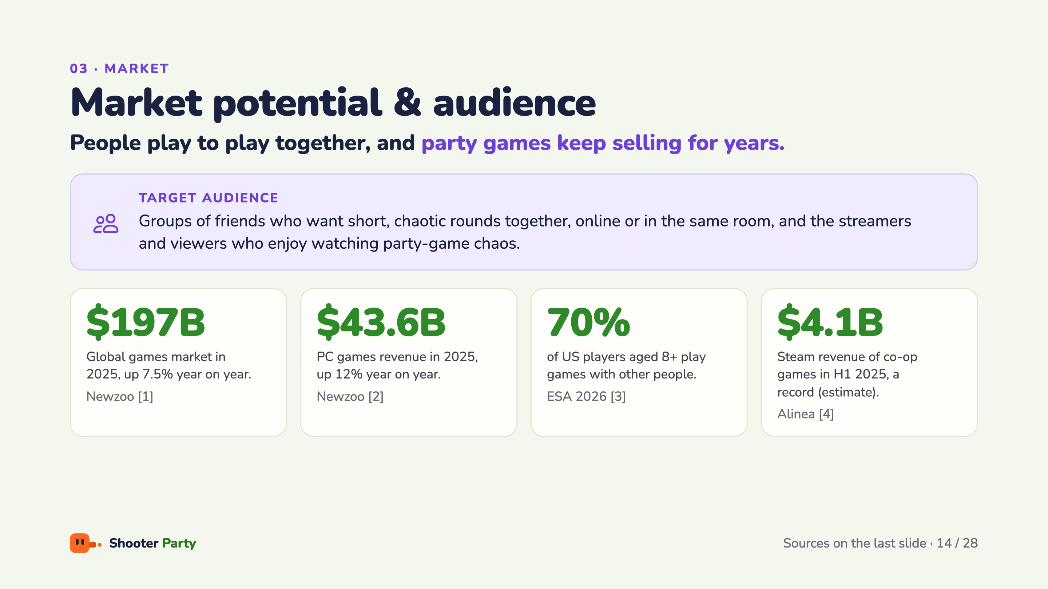
Notes:
Our audience is groups of friends who want short, chaotic rounds together, online or in the same room, plus the streamers and viewers who enjoy watching party-game chaos. The market is large and growing: about 197 billion dollars globally in 2025 (Newzoo), PC up 12 percent to 43.6 billion, 70 percent of US players aged 8 and up play with other people (ESA 2026), and co-op games on Steam made an estimated 4.1 billion in the first half of 2025, a record (Alinea).

Slide 15
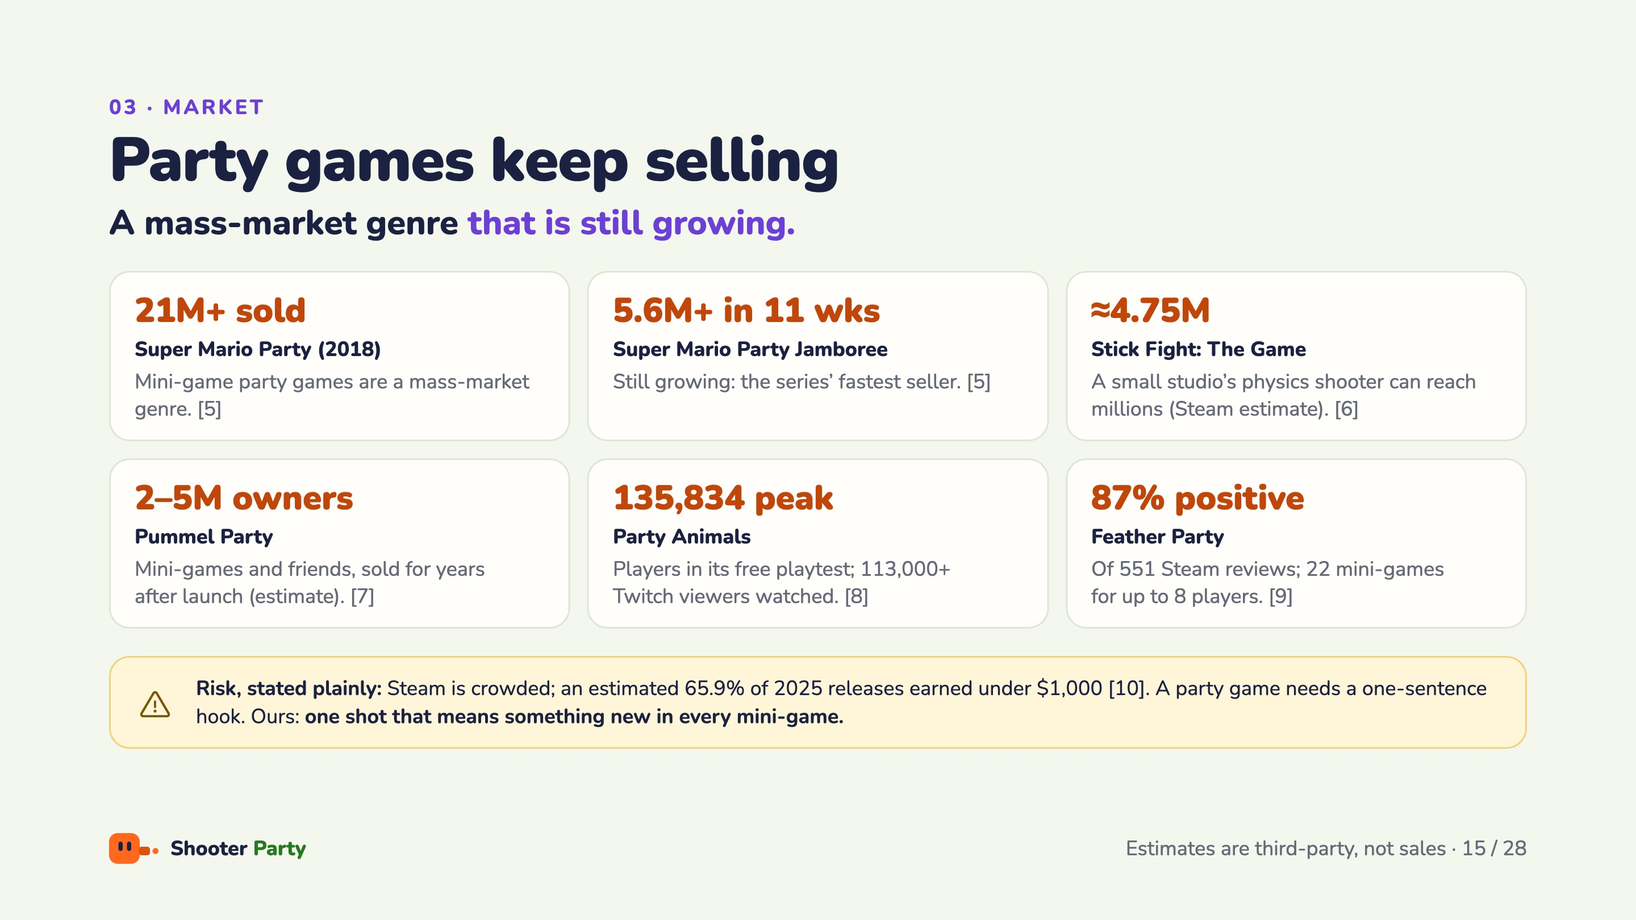
Notes:
Proof that the genre sells for years. Super Mario Party (2018) sold over 21 million; Jamboree sold 5.6 million in 11 weeks, the series’ fastest seller. Stick Fight shows a small studio’s physics shooter can reach millions. Pummel Party is estimated at 2 to 5 million owners. Party Animals peaked at 135,834 players in its free playtest, with over 113,000 watching on Twitch. Feather Party has 87 percent positive of 551 reviews. The risk, stated plainly: an estimated 65.9 percent of 2025 Steam releases earned under 1,000 dollars, so we need a one-sentence hook: one shot that means something new in every mini-game.

Slide 16
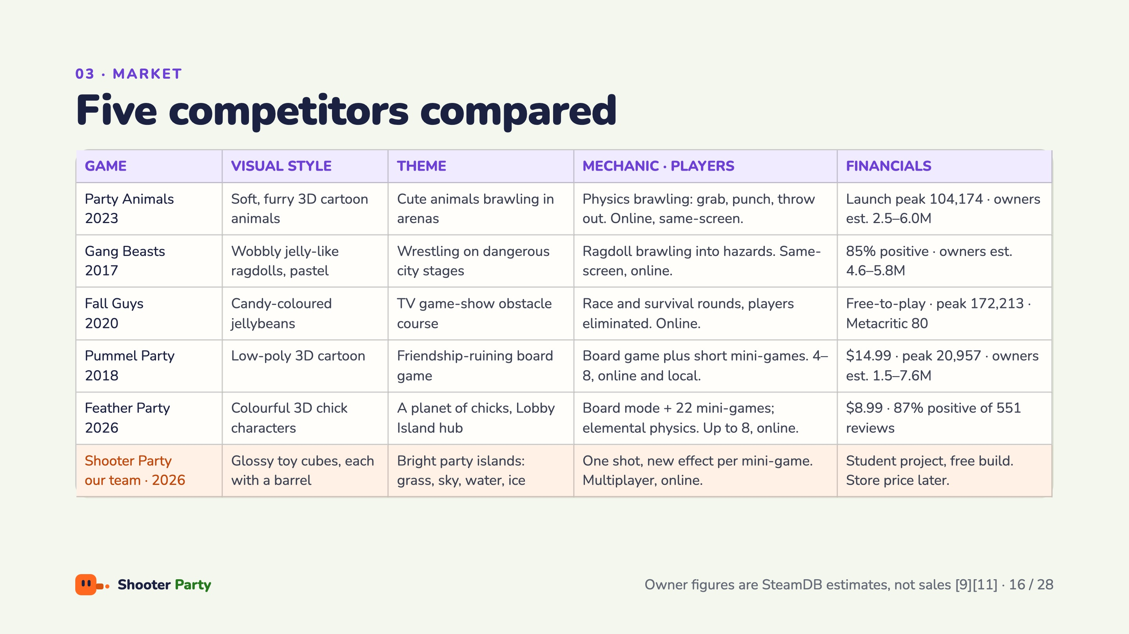
Notes:
Five games compared by look, theme, mechanic and money. Party Animals (Recreate Games), Gang Beasts (Boneloaf), Fall Guys (Mediatonic / Epic), Pummel Party (Rebuilt Games) and Feather Party (threeW). Owner numbers are third-party SteamDB estimates, not sales; Feather Party figures come from its Steam page. Our row: glossy toy cubes with a barrel, bright party islands, one shot whose effect changes per mini-game, online multiplayer, and a free student build; a store price is a later decision.

Slide 17
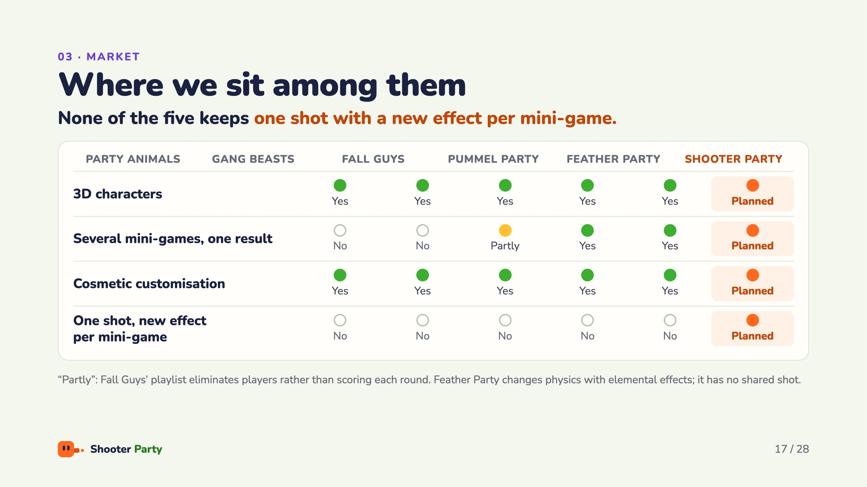
Notes:
Across the four features, everyone has 3D characters and cosmetics; Pummel Party and Feather Party also combine several mini-games into one result, and Fall Guys partly does, since its playlist eliminates players instead of scoring each round. The last row is the gap we fill: none of the five keeps one shot with a new effect per mini-game. For Shooter Party every item is planned, since this is the proposal stage.

Slide 18
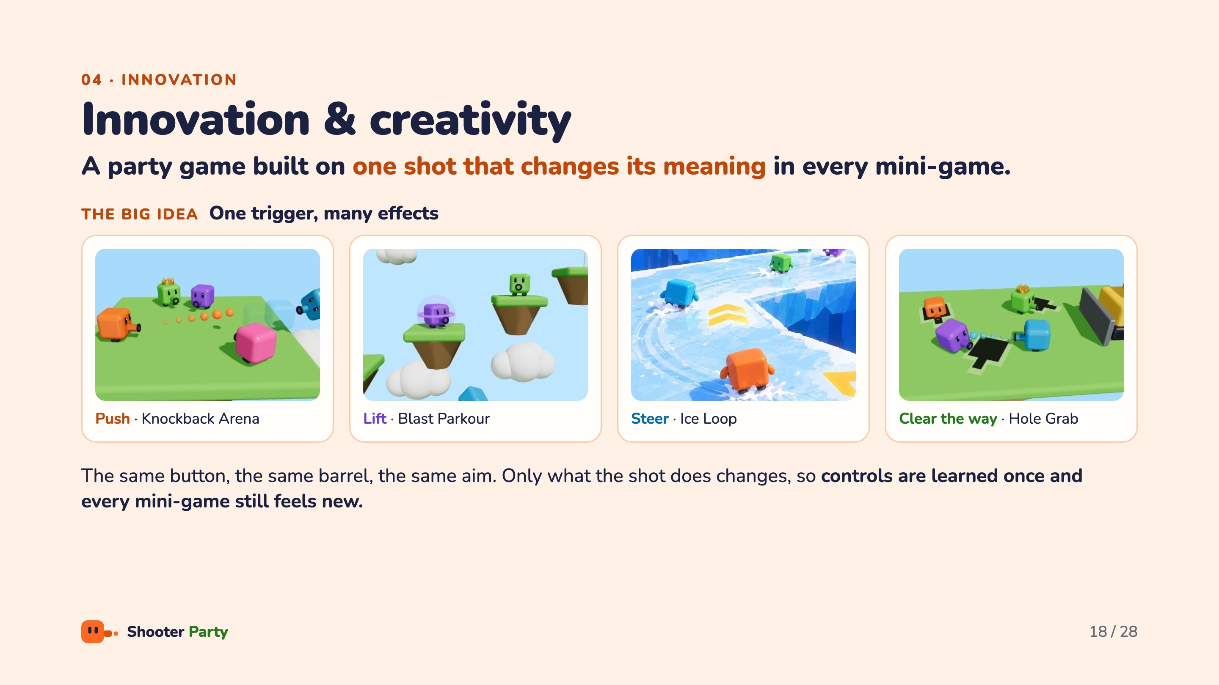
Notes:
This is the heart of the pitch. The big idea is one trigger, many effects: the same button, the same barrel and the same aim in every mini-game. Only what the shot does changes. In Knockback Arena it pushes, in Blast Parkour it lifts you, in Ice Loop it steers you with recoil, and in Hole Grab it clears the way to a hole. Players learn the controls once, and every mini-game still feels new.

Slide 19
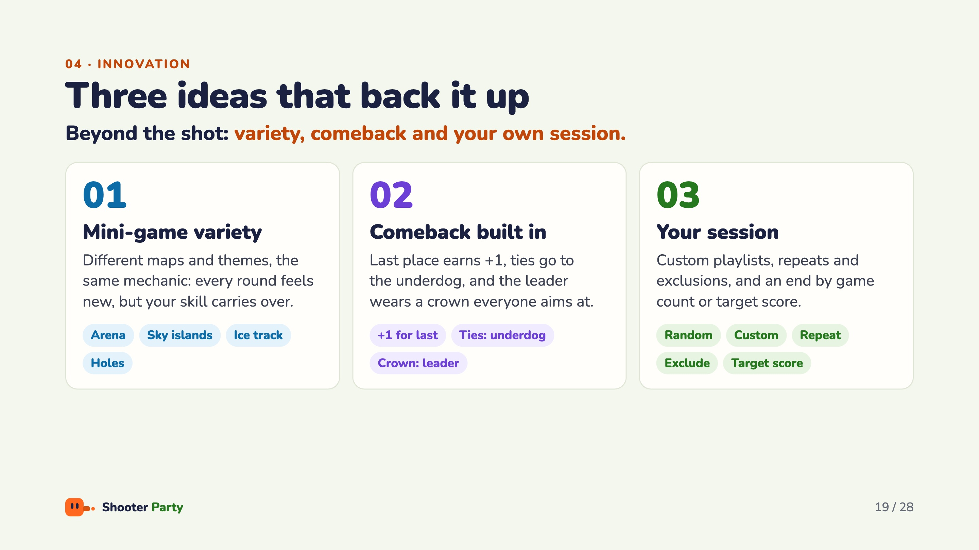
Notes:
Three ideas back up the big idea. First, mini-game variety: different maps and themes, such as the arena, sky islands, the ice track and the holes field, all built on the same mechanic, so every round feels new while your skill carries over. Second, the comeback is built in: last place earns a point, ties go to the underdog, and the leader wears a crown everyone aims at. Third, it is your session: custom playlists, repeats and exclusions, and an end by game count or target score.

Slide 20
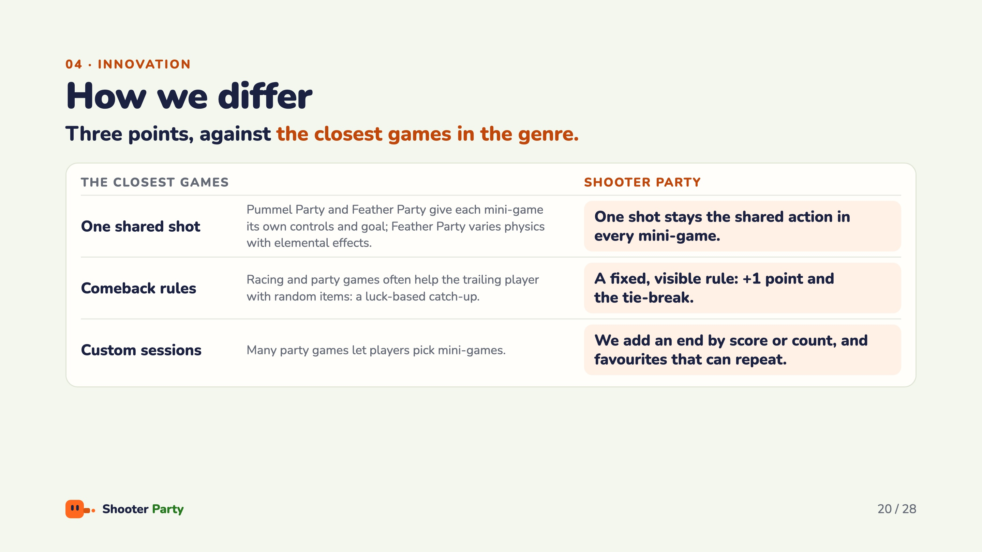
Notes:
How this differs from the closest games. Pummel Party and Feather Party give each mini-game its own controls and goal; neither keeps one shot as the shared action. Many racing and party games help the trailing player with random items, a luck-based catch-up; ours is a fixed, visible rule. And beyond picking mini-games, we add an end by score or count, and favourites that can repeat.

Slide 21
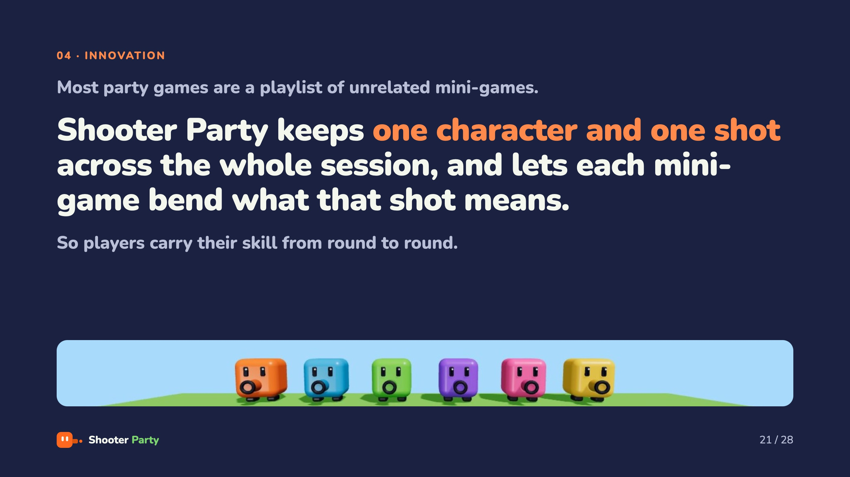
Notes:
Pause here and say it slowly. Most party games are a playlist of unrelated mini-games. Shooter Party keeps one character and one shot across the whole session and lets each mini-game bend what that shot means, so players carry their skill from round to round. This is what sets us apart.

Slide 22
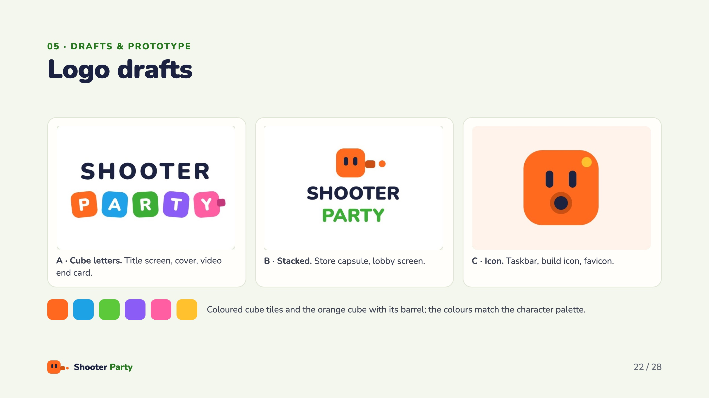
Notes:
Three logo directions for the same identity. A, cube letters, for the title screen, cover and the video end card. B, stacked, for the store capsule and lobby screen. C, the icon, for the taskbar, build icon and favicon. They share coloured cube tiles and the orange cube with its barrel, and the colours match the character palette. We pick one after your feedback.

Slide 23
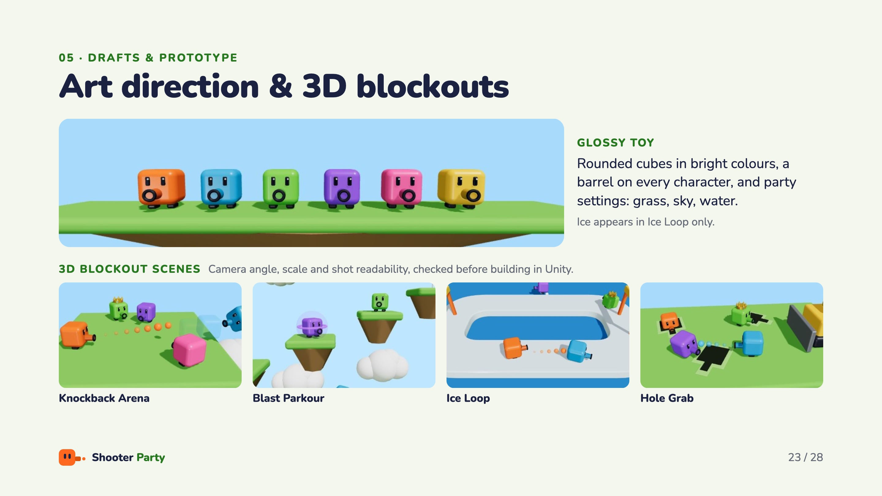
Notes:
Art direction: glossy toy. Rounded cubes in bright colours, a barrel on every character, and party settings such as grass, sky and water; ice appears in Ice Loop only. Each mini-game was blocked out in 3D to check the camera angle, the scale and how readable the shots are, before building it in Unity.

Slide 24
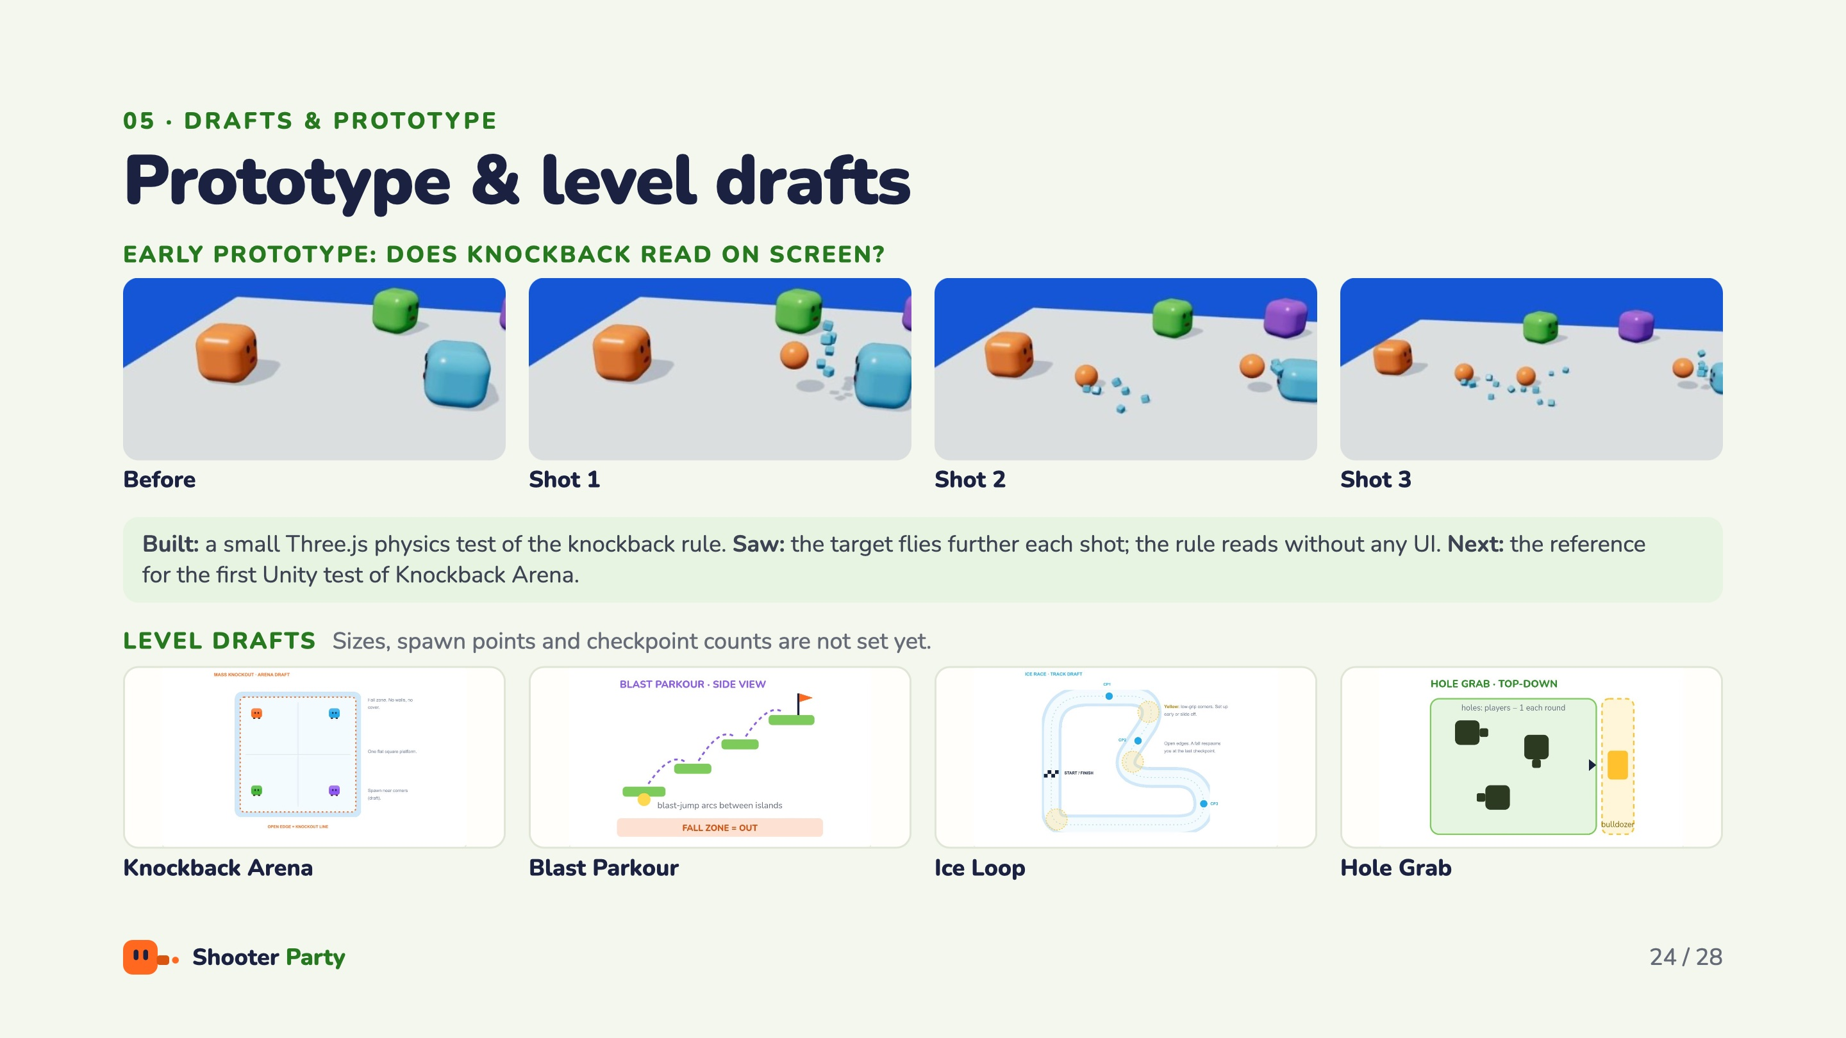
Notes:
Our early prototype asked one question: does knockback read on screen? We built a small physics test of the knockback rule in Three.js and rendered it frame by frame. Over three shots the target flies further each time, and the rule reads without any UI. It is the reference for the first Unity test of Knockback Arena: same scene, same rule. Below are the level drafts for scope and blockout; sizes, spawn points and checkpoint counts are not set yet.

Slide 25
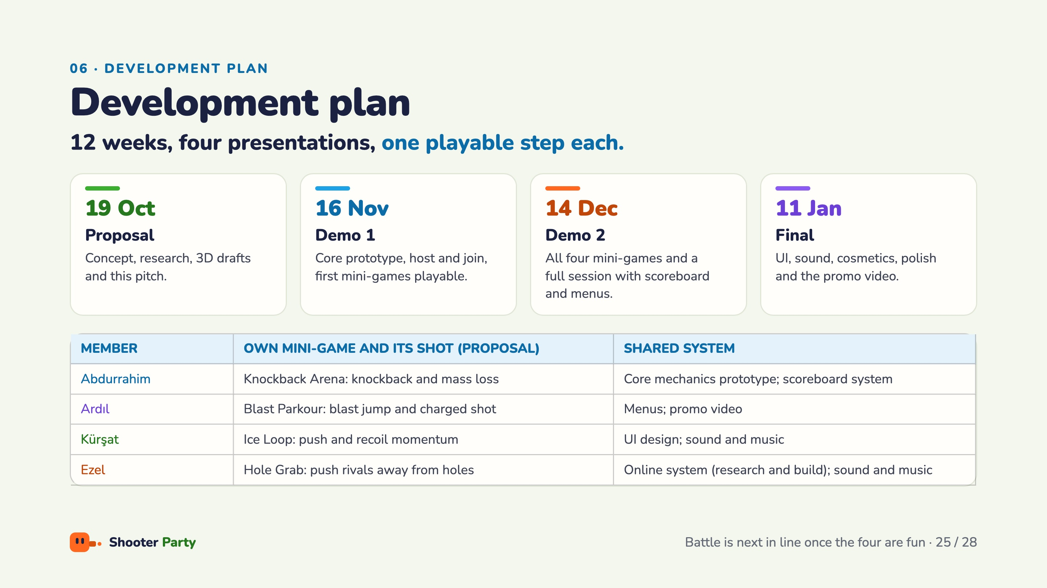
Notes:
Twelve weeks, four presentations, and one playable step each: today’s proposal, Demo 1 on 16 November with the core prototype, host and join and the first mini-games, Demo 2 on 14 December with all four mini-games and a full session, and the final on 11 January with UI, sound, cosmetics, polish and the promo video. Everyone designs and builds at least one mini-game, including what the shot does in it, and finds its assets; each member also owns one shared system. The assignments are a proposal; Battle is next in line once the four are fun.

Slide 26
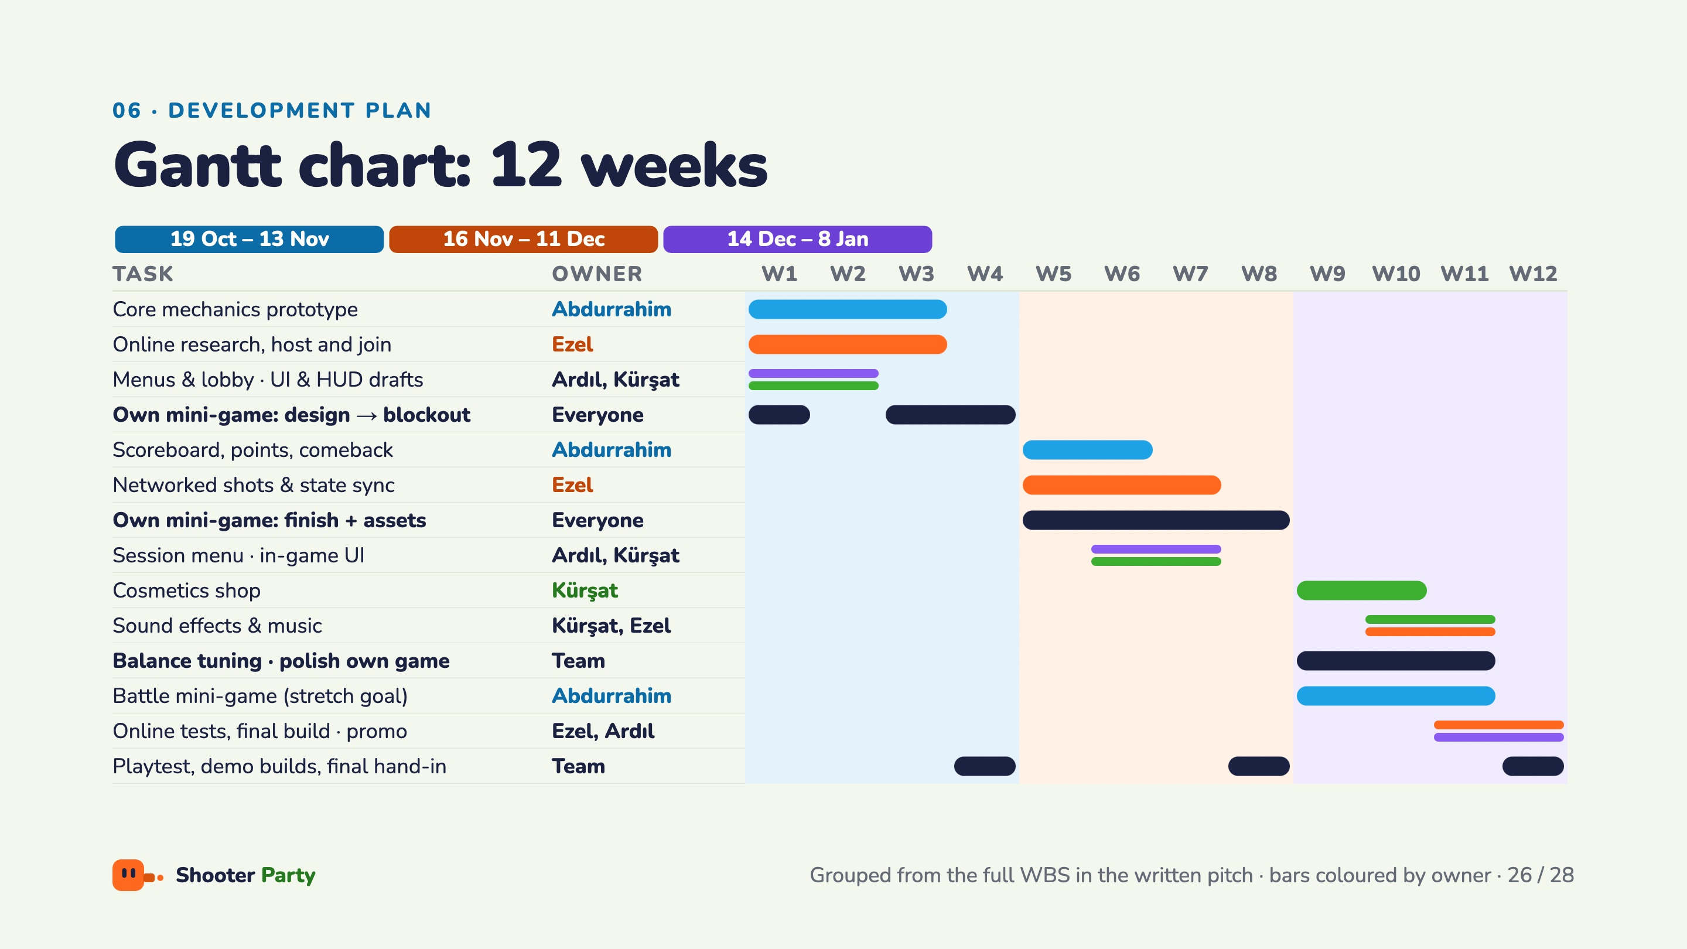
Notes:
Each column is one course week; week 1 starts on 19 October. Bars are coloured by owner: Ezel orange, Abdurrahim blue, Kürşat green, Ardıl purple, and everyone or the whole team in navy; split bars mean two owners. Demo 1 phase: core prototype and online host and join in weeks 1 to 3, menus and UI drafts in weeks 1 and 2, mini-game design in week 1 and blockouts in weeks 3 and 4. Demo 2 phase: scoreboard, networked shots, finishing each mini-game with its assets, session menu and in-game UI, then the first full-session playtest. Final phase: cosmetics, sound, balance and polish, Battle as a stretch goal, online tests, the promo video and the final hand-in in week 12. The full 26-task breakdown is in the written pitch.

Slide 27
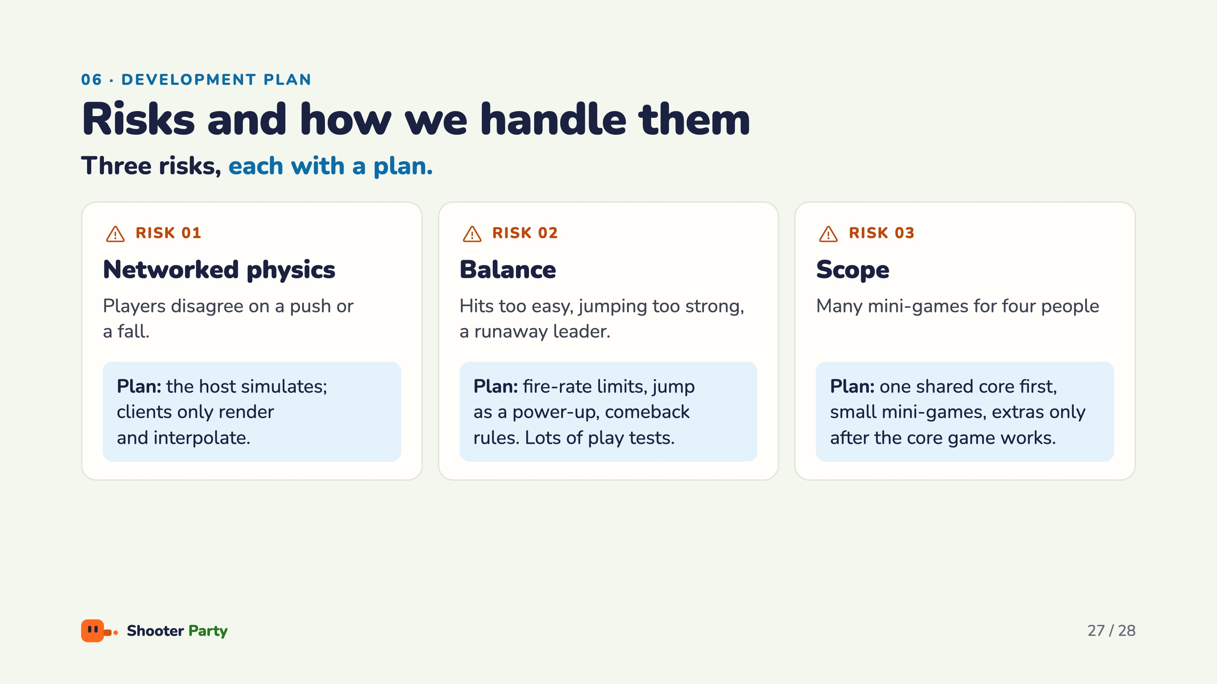
Notes:
Three risks, each with a plan. Networked physics: players could disagree on a push or a fall, so the host simulates and clients only render and interpolate. Balance: hits too easy, jumping too strong or a runaway leader, handled with fire-rate limits, jump as a power-up and the comeback rules. Scope: four mini-games by four people, so we build one shared core first, keep the mini-games small, and add extras only after the core game works.

Slide 28
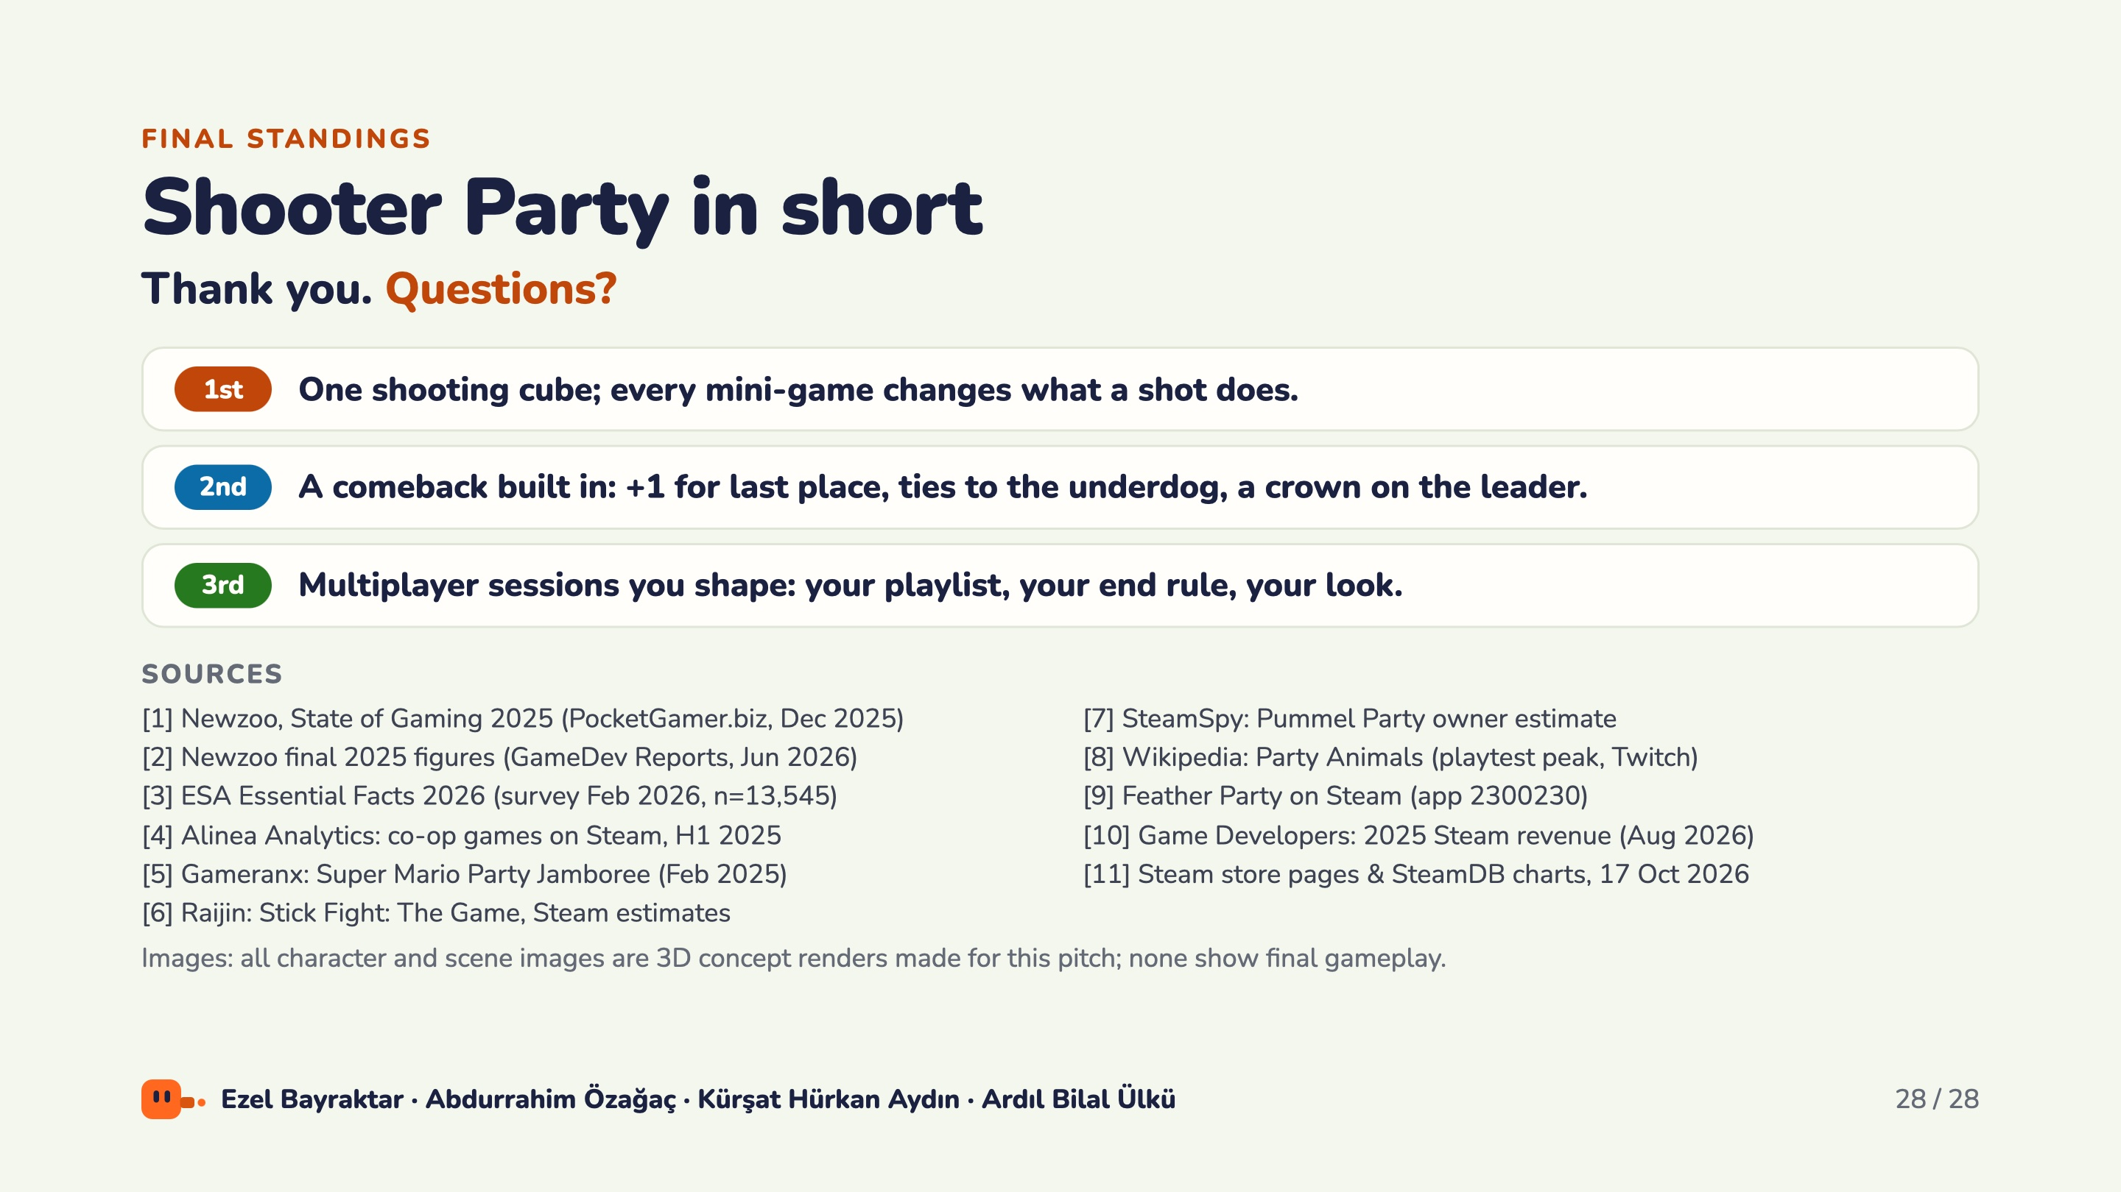
Notes:
Close with the three takeaways. First: one shooting cube, and every mini-game changes what a shot does. Second: a comeback built in, with a point for last place, ties to the underdog and a crown on the leader. Third: multiplayer sessions you shape, with your playlist, your end rule and your look. Thank the audience and invite questions; the sources for every figure are listed here and in the written pitch.

